Slide 1
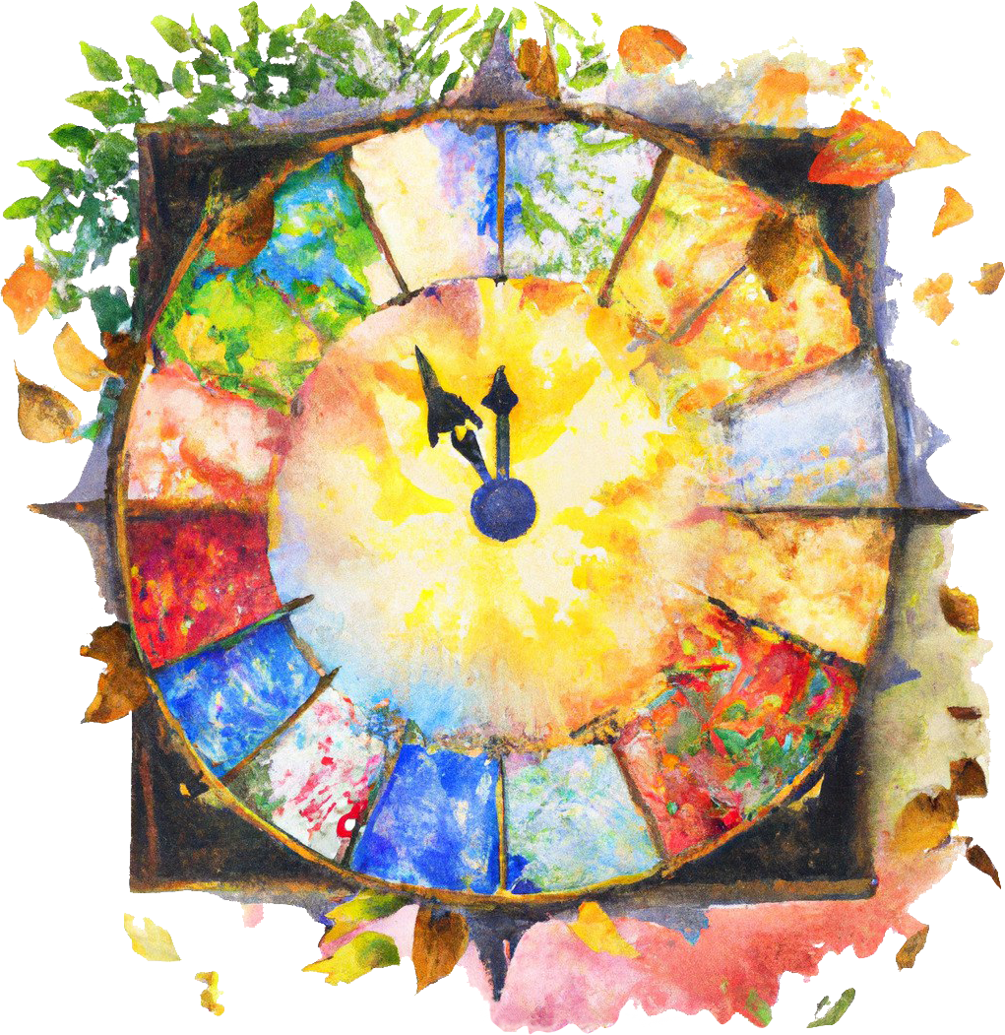
Multi-omics Characterization of the Responses to Seasonal Variations in Diel Cycles in the Marine Picoeukaryote Ostreococcus tauri
Doctoral thesis of
Ana Belén Romero-Losada
Notes:
Thank you for the presentation. First, I would like to express my sincere gratitude for your presence here today and with your permission, I would like to start the oral presentation of my doctoral thesis.

Slide 2
Index
Introduction
Hypothesis and Objectives
Results and Discussion
Conclusions
Notes:
I will take you through an exploration of this work organized into four sections.

Slide 3
Index
Introduction
Hypothesis and Objectives
Results and Discussion
Conclusions
Notes:
We will begin with the Introduction, setting the context and significance of my research.

Slide 4
Index
Introduction
Hypothesis and Objectives
Results and Discussion
Conclusions
Notes:
Following this, I will indicate the Hypothesis and Objectives,

Slide 5
Index
Introduction
Hypothesis and Objectives
Results and Discussion
Conclusions
Notes:
and each objective will be approached in the different chapters included in the Results section.

Slide 6
Index
Introduction
Hypothesis and Objectives
Results and Discussion
Conclusions
Notes:
Finally, we will, as expected, conclude enumerating the relevant Conclusions of this work

Slide 7
Introduction: Chronobiology
Gravitational forces exerted by the Sun over our planet generate cyclic enviromental signals like diel and seasonal cycles.
Notes:
SO, Gravitational forces exerted by the Sun over our planet generate cyclic enviromental signals like

Slide 8
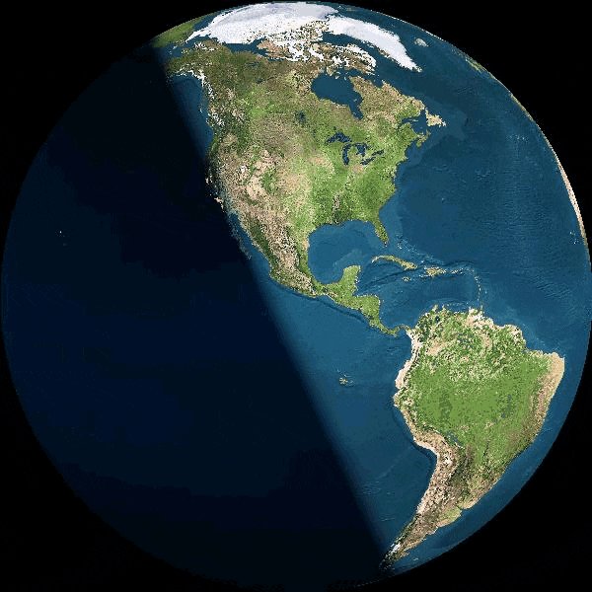
Introduction: Chronobiology
Gravitational forces exerted by the Sun over our planet generate cyclic enviromental signals like diel and seasonal cycles.
Diel cycle
(days)
Notes:
diel cycles caused by earth rotation

Slide 9
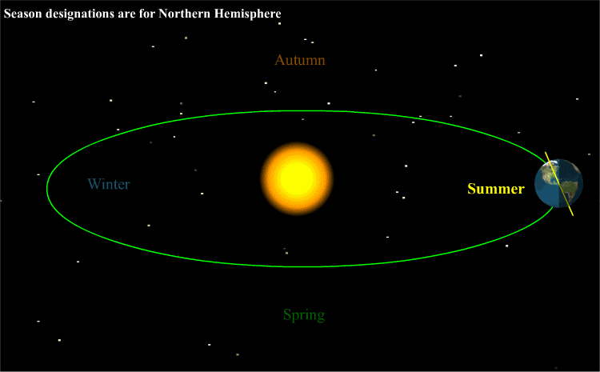
Introduction: Chronobiology
Gravitational forces exerted by the Sun over our planet generate cyclic enviromental signals like diel and seasonal cycles.
Diel cycle
(days)
Seasonal cycle (change of seasons)
Notes:
and seasonal cycles caused by earth translation around the sun. That movement produce changes in day length or photoperiods.

Slide 10
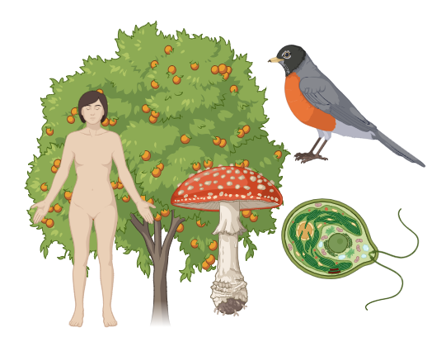
Introduction: Chronobiology
(Kuhlman et al., 2018)
Notes:
Earth living organisms

Slide 11
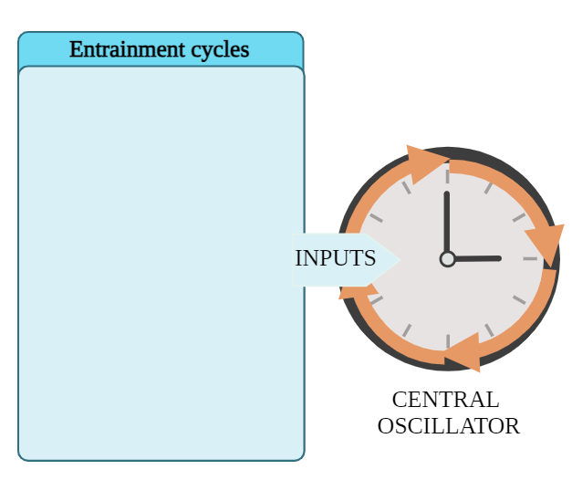



Introduction: Chronobiology
(Kuhlman et al., 2018)
Notes:
are strongly affected by those cyclic environmental changes.

Slide 12
Introduction: Chronobiology
Endogenous molecular systems
allow erathlings to anticipate cyclic changes
(Kuhlman et al., 2018)
Notes:
Therefore, we have evolved an endogenous molecular system that allow us to anticipate those changes.

Slide 13

Introduction: Chronobiology
Endogenous molecular systems
allow erathlings to anticipate cyclic changes
(Kuhlman et al., 2018)
Notes:
This endogenous molecular system is called circadian clock

Slide 14
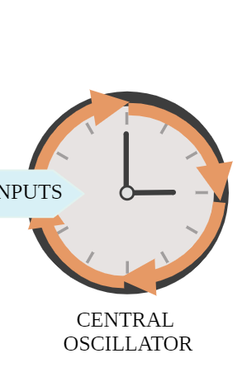
Introduction: Chronobiology
CIRCADIAN CLOCK
CIRCADIAN CLOCK
(Kuhlman et al., 2018)
Notes:
and can be seen as A central oscillator that IS susceptible to be entrained by environmental rhythmic or cyclic inputs.

Slide 15
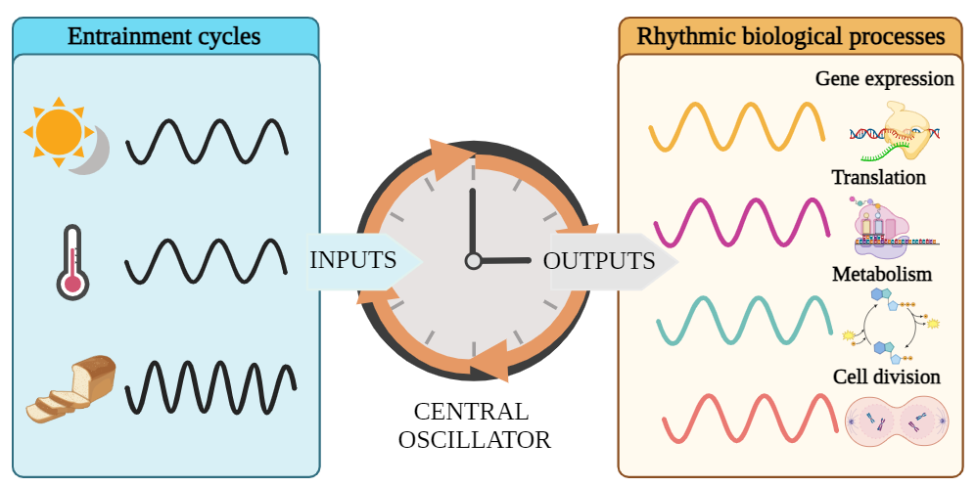
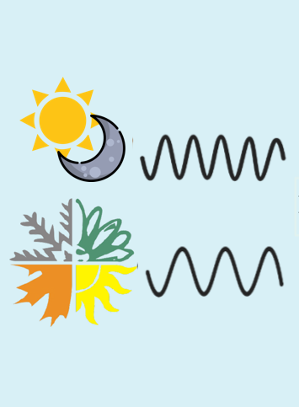
Introduction: Chronobiology
CIRCADIAN CLOCK
CIRCADIAN CLOCK
(Kuhlman et al., 2018)
Notes:
In turn, it generate rhythmic outputs controlling a wide range of biological processes

Slide 16
Introduction: Chronobiology
CIRCADIAN CLOCK
(Kuhlman et al., 2018)
Notes:
that are the focus of this work.

Slide 17

Introduction: Chronobiology
Biological rhythm modelled as wave
(Parsons et al., 2020)
Notes:
Those biological rhythms can be modelled as waves.

Slide 18

Introduction: Chronobiology
Biological rhythm modelled as wave
(Parsons et al., 2020)
Notes:
Those biological rhythms can be modelled as waves.

Slide 19
Introduction: Chronobiology
Biological rhythm modelled as wave
??
vs
(Parsons et al., 2020)
Notes:
There are wave parameters that can be used to compare different waves see the differences between them. Im going to introduce some of these pararameters

Slide 20
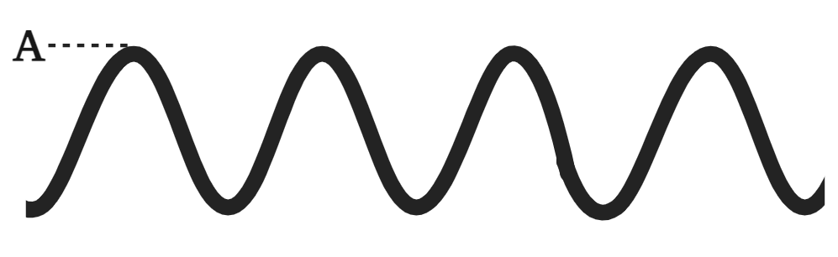
Introduction: Chronobiology
Biological rhythm modelled as wave
(Parsons et al., 2020)
Notes:
Here “A” stands for amplitude and it corresponds to the maximum value of the wave

Slide 21
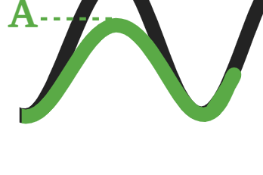
Introduction: Chronobiology
Biological rhythm modelled as wave
(Parsons et al., 2020)
Notes:
The green oscillation represents a wave with a different amplitude when compared to the black wave.

Slide 22
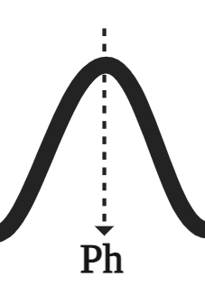
Introduction: Chronobiology
Biological rhythm modelled as wave
(Parsons et al., 2020)
Notes:
“Ph” stands for phase, which corresponds to the time point when the wave reaches its maximum value.

Slide 23
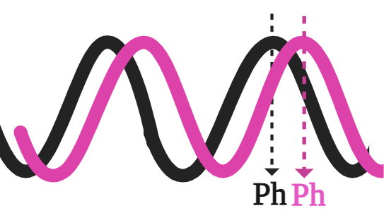
Introduction: Chronobiology
Biological rhythm modelled as wave
(Parsons et al., 2020)
Notes:
The pink oscillation represents a wave with different phase compared to the black wave.

Slide 24
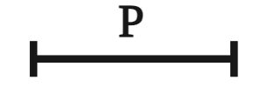
Introduction: Chronobiology
Biological rhythm modelled as wave
(Parsons et al., 2020)
Notes:
“P” stands for period, which corresponds to the time interval between consecutive repetitions of the wave pattern. In circadian research, period is commonly set as 24h, the duration of a diel cycle.

Slide 25
Introduction: Chronobiology
Biological rhythm modelled as wave
=24h in diel cycles
(Parsons et al., 2020)
Notes:
In diel cycles the period is set as 24h.

Slide 26
Introduction: Chronobiology
(Roenneberg & Merrow, 2005)
Entrainment oscillation
(Rhythmic signal)
Free-running
(Constant signal)
Biological rhythms
Process responding to rhythmic signals
Self-sustained biological rhythm
Notes:
Typically, when a rhythmic environmental signal is studied,

Slide 27
Introduction: Chronobiology
(Roenneberg & Merrow, 2005)
Entrainment oscillation
(Rhythmic signal)
Free-running
(Constant signal)
Biological rhythms
Process responding to rhythmic signals
Self-sustained biological rhythm
Notes:
several biological processes are found showing rhythmic profiles.

Slide 28
Introduction: Chronobiology
(Roenneberg & Merrow, 2005)
Entrainment oscillation
(Rhythmic signal)
Free-running
(Constant signal)
Biological rhythms
Process responding to rhythmic signals
Self-sustained biological rhythm
Notes:
Then, when the rhythmic signal becomes constant, which is called free-running conditions.

Slide 29
Introduction: Chronobiology
(Roenneberg & Merrow, 2005)
Entrainment oscillation
(Rhythmic signal)
Free-running
(Constant signal)
Biological rhythms
Process responding to rhythmic signals
Self-sustained biological rhythm
Notes:
Some of these biological processes do not maintain their rhythmicity, indicating that their rhythmic profiles are direct responses to changes in the environment.

Slide 30
Introduction: Chronobiology
(Roenneberg & Merrow, 2005)
Entrainment oscillation
(Rhythmic signal)
Free-running
(Constant signal)
Biological rhythms
Process responding to rhythmic signals
Self-sustained biological rhythm
Notes:
However, a subset of biological processes would maintain a rhythmic profile under constant environmental conditions

Slide 31

Introduction: Chronobiology
(Roenneberg & Merrow, 2005)
Entrainment oscillation
(Rhythmic signal)
Free-running
(Constant signal)
Biological rhythms
Process responding to rhythmic signals
Self-sustained biological rhythm
Notes:
this behaviour is characteristic of clock-regulated biological rhythms, meaning that they only rely on the rhythmic environmental signal to be entrained but not to maintain its rhythm

Slide 32
Introduction: Chronobiology
Entrainment oscillation
(Rhythmic signal)
Free-running
(Constant signal)
Biological rhythms
Process responding to rhythmic signals
Animals
(Roenneberg et al., 2022)
Fungus
Self-sustained biological rhythm
(Correa & Bell-Pedersen, 2002)
Plants and
algae
(Serrano-Bueno et al., 2017).
Notes:
Following this experimental design, chronobiologists have described biological rhythms in almost all phyla, from animals to fungus, plants and algae.

Slide 33
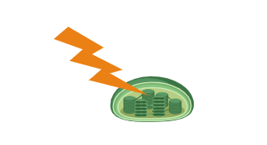
Introduction: Chronobiology
Entrainment oscillation
(Rhythmic signal)
Free-running
(Constant signal)
Biological rhythms
Process responding to rhythmic signals
Animals
(Roenneberg et al., 2022)
Fungus
Self-sustained biological rhythm
(Correa & Bell-Pedersen, 2002)
Plants and
algae
(Serrano-Bueno et al., 2017).
Light is the main energy source in photosynthetic organisms
Notes:
In fact, for photosynthesis organisms like plants and algae light is their main energy source

Slide 34
Introduction: Chronobiology
Entrainment oscillation
(Rhythmic signal)
Free-running
(Constant signal)
Biological rhythms
Process responding to rhythmic signals
Animals
(Roenneberg et al., 2022)
Fungus
Self-sustained biological rhythm
(Correa & Bell-Pedersen, 2002)
Plants and
algae
(Serrano-Bueno et al., 2017).
Light is the main energy source in photosynthetic organisms
Highly affected by diel cycles and photoperiods
(Noordally & Millar, 2015)
Notes:
so they are highly affected cyclic environmental changes like diel cycles and changes in day length or photoperiods during seasonal cycles

Slide 35
Introduction: Chronobiology
Entrainment oscillation
(Rhythmic signal)
Free-running
(Constant signal)
Biological rhythms
Process responding to rhythmic signals
Animals
(Roenneberg et al., 2022)
Fungus
Self-sustained biological rhythm
(Correa & Bell-Pedersen, 2002)
Plants and
algae
(Serrano-Bueno et al., 2017).
Light is the main energy source in photosynthetic organisms
Highly affected by diel cycles and photoperiods
(Noordally & Millar, 2015)
Ostreococcus tauri
Notes:
In order, to focus on this responses in photosynthetic organisms Ostreococcus tauri is chosen as a model organism in this work, based in several reasons.

Slide 36
Introduction: Ostreococcus tauri
(Benites et al., 2021)
(Leliaert et al., 2011)
Notes:
Otauri is an aukariotic photosynthetic organism that is include in Viridiplantae, here

Slide 37
Introduction: Ostreococcus tauri
Viridiplantae
(green lineage)
(Benites et al., 2021)
(Leliaert et al., 2011)
Notes:
Viridiplantae which is the taxonomic name for the green lineage

Slide 38
Introduction: Ostreococcus tauri
Viridiplantae
(green lineage)
Microalgae
(Benites et al., 2021)
(Leliaert et al., 2011)
Plants
Notes:
That includes microalgae and plants

Slide 39
Introduction: Ostreococcus tauri
Viridiplantae
(green lineage)
Microalgae
(Benites et al., 2021)
(Leliaert et al., 2011)
Plants
Notes:
That includes microalgae and plants

Slide 40
Introduction: Ostreococcus tauri
Viridiplantae
(green lineage)
Chlorophyta
Microalgae
Charophyta
(Benites et al., 2021)
(Leliaert et al., 2011)
Plants
Notes:
Microalgae inside the green lineage are organized in two main groups chlorophyta and charophyta.

Slide 41
Introduction: Ostreococcus tauri
Viridiplantae
(green lineage)
Chlorophyta
Microalgae
(elder sisters
of plants)
Charophyta
(Benites et al., 2021)
(Leliaert et al., 2011)
Plants
Notes:
According to phylogenomic studies, microalgae could be considered the ancestors or elder sisters of plants

Slide 42
Introduction: Ostreococcus tauri
Viridiplantae
(green lineage)
Chlorophyta
Microalgae
(elder sisters
of plants)
Charophyta
(Benites et al., 2021)
(Leliaert et al., 2011)
Plants
Notes:
and Ostreococcus tauri could be considered the eldest sister of the complete green lineage. so the molecular systems that are characterized in ostreococcus could be more easily extrapolated to other organisms in the green lineage.

Slide 43
Introduction: Ostreococcus tauri
Electron microscopy image of Ostreococcus tauri from
(Henderson et al., 2012)
Notes:
Apart from that, Ostreococcus is also interesting because its simple cell structure .

Slide 44
Introduction: Ostreococcus tauri
Electron microscopy image of Ostreococcus tauri from
Smallest free-living eukaryote
(Henderson et al., 2012)
Notes:
It is the smallest free living eukariote known to date

Slide 45
Introduction: Ostreococcus tauri
Electron microscopy image of Ostreococcus tauri from
Smallest free-living eukaryote
(Henderson et al., 2012)
Notes:
and it only present one chloroplast

Slide 46
Introduction: Ostreococcus tauri
Electron microscopy image of Ostreococcus tauri from
Smallest free-living eukaryote
(Henderson et al., 2012)
Notes:
One mitocondria

Slide 47
Introduction: Ostreococcus tauri
Electron microscopy image of Ostreococcus tauri from
Smallest free-living eukaryote
(Henderson et al., 2012)
Notes:
and the rest of basic organella, leaving almost no citoplasmatic free space.

Slide 48

Introduction: Ostreococcus tauri
Electron microscopy image of Ostreococcus tauri from
Crucial contribution to marine phytoplankton
Smallest free-living eukaryote
(Henderson et al., 2012)
(Benites et al., 2021; Bolaños et al., 2020)
Notes:
However, in spite of its reduced size, its contribution to marine phytoplankton is crucial in a wide range of oceans and seas all over the world

Slide 49
Introduction: Ostreococcus tauri
 | Genome size (Mb) | Number of protein coding genes | Number of transcription factors
Ostreococcuus tauri | 12.56 | 8166 | 102
(Blanc-Mathieu et al., 2014)
Notes:
In addition, nowadays the small genome of Ostreococcus is full sequenced is fully sequenced and annotated.
PREGUNTA POR LA NUEVA? Nuevas versions del genoma con 13mb 7668 genes y 147 FT

Slide 50
Introduction: Ostreococcus tauri
 | Genome size (Mb) | Number of protein coding genes | Number of transcription factors
Arabidopsis thaliana | 135 | 27474 | 1779
Klebsormidium nitens | 104 | 17055 | 286
Chlamydomonas reinhardtii | 110 | 14000 | 279
Phaeodactylum tricornutum | 27.4 | 10567 | 212
Ostreococcuus tauri | 12.56 | 8166 | 102
(Blanc-Mathieu et al., 2014)
(Blaby et al., 2014)
(Hori et al., 2014)
(Lamesch et al., 2012)
(Craig et al., 2021)
(Swarbreck et al., 2008)
(Derelle et al., 2006)
(M. Yang et al., 2018)
Notes:
Its simplicity is easily observed when its genome features are compared with other microalgae.

Slide 51
Introduction: Ostreococcus tauri
 | Genome size (Mb) | Number of protein coding genes | Number of transcription factors
Arabidopsis thaliana | 135 | 27474 | 1779
Klebsormidium nitens | 104 | 17055 | 286
Chlamydomonas reinhardtii | 110 | 14000 | 279
Phaeodactylum tricornutum | 27.4 | 10567 | 212
Ostreococcuus tauri | 12.56 | 8166 | 102
(Blanc-Mathieu et al., 2014)
(Blaby et al., 2014)
(Hori et al., 2014)
(Lamesch et al., 2012)
organism with the highest gene density
(Craig et al., 2021)
(Swarbreck et al., 2008)
(Derelle et al., 2006)
(M. Yang et al., 2018)
Notes:
Ostreococcus present around 8000 protein coding genes, which makes this microalgae the organism with the highest gene density

Slide 52
Introduction: Ostreococcus tauri
 | Genome size (Mb) | Number of protein coding genes | Number of transcription factors
Arabidopsis thaliana | 135 | 27474 | 1779
Klebsormidium nitens | 104 | 17055 | 286
Chlamydomonas reinhardtii | 110 | 14000 | 279
Phaeodactylum tricornutum | 27.4 | 10567 | 212
Ostreococcuus tauri | 12.56 | 8166 | 102
(Blanc-Mathieu et al., 2014)
(Blaby et al., 2014)
(Hori et al., 2014)
(Lamesch et al., 2012)
organism with the highest gene density
(Craig et al., 2021)
(Swarbreck et al., 2008)
(Derelle et al., 2006)
(M. Yang et al., 2018)
Notes:
its number of TF around 100

Slide 53
Introduction: Ostreococcus tauri
 | Genome size (Mb) | Number of protein coding genes | Number of transcription factors
Arabidopsis thaliana | 135 | 27474 | 1779
Klebsormidium nitens | 104 | 17055 | 286
Chlamydomonas reinhardtii | 110 | 14000 | 279
Phaeodactylum tricornutum | 27.4 | 10567 | 212
Ostreococcus tauri | 12.56 | 8166 | 102
(Blanc-Mathieu et al., 2014)
(Blaby et al., 2014)
(Hori et al., 2014)
(Lamesch et al., 2012)
Only one copy of most genes
organism with the highest gene density
(Craig et al., 2021)
(Swarbreck et al., 2008)
(Derelle et al., 2006)
(M. Yang et al., 2018)
Notes:
and present only one copy of most genes.

Slide 54
Introduction: Ostreococcus tauri
 | Genome size (Mb) | Number of protein coding genes | Number of transcription factors
Arabidopsis thaliana | 135 | 27474 | 1779
Klebsormidium nitens | 104 | 17055 | 286
Chlamydomonas reinhardtii | 110 | 14000 | 279
Phaeodactylum tricornutum | 27.4 | 10567 | 212
Ostreococcus tauri | 12.56 | 8166 | 102
(Blanc-Mathieu et al., 2014)
(Blaby et al., 2014)
(Hori et al., 2014)
(Lamesch et al., 2012)
Only one copy of most genes
Molecular systems including only the basics to function
organism with the highest gene density
(Craig et al., 2021)
(Swarbreck et al., 2008)
(Derelle et al., 2006)
(M. Yang et al., 2018)
Notes:
and its molecular systems include only the basics required to function.

Slide 55

Introduction: Ostreococcus tauri
 | Genome size (Mb) | Number of protein coding genes | Number of transcription factors
Arabidopsis thaliana | 135 | 27474 | 1779
Klebsormidium nitens | 104 | 17055 | 286
Chlamydomonas reinhardtii | 110 | 14000 | 279
Phaeodactylum tricornutum | 27.4 | 10567 | 212
Ostreococcuus tauri | 12.56 | 8166 | 102
Ostreococcus
Ostreococcus tauri is chosen as a model organism in this work for its phylogenomic position in the green lineage, its significant presence in marine phytoplankton and its simple cell structure and genome features.
(Blanc-Mathieu et al., 2014)
Notes:
Overall, Ostreococcus tauri is chosen as a model organism in this work for its phylogenomic position in the green lineage, its significant presence in marine phytoplankton and its simple cell structure and genome features.

Slide 56
Introduction: Systems Biology
Notes:
Specifically, the simple genomic features that Ostreococcus tauri presents could make it an excellent model organism for Systems Biology studies, like the one achieved in this work.

Slide 57
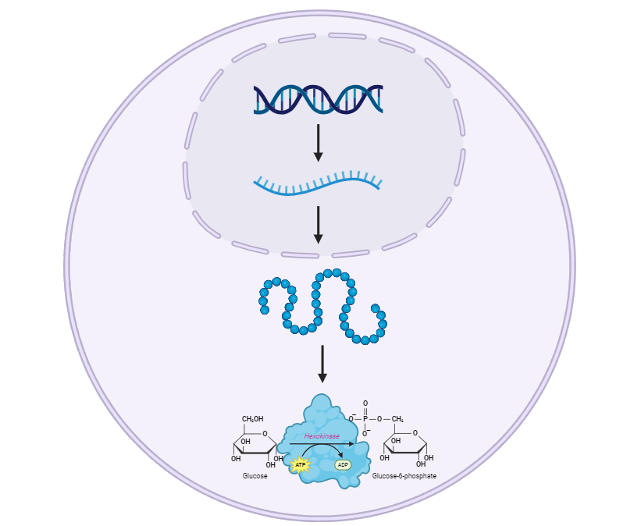
Introduction: Systems Biology
(Veenstra, 2021)
Genomics and epigenomics
Transcriptomics
Proteomics
Metabolomics
Notes:
Systems biology is based in the integration of omic data generated with omic techniques.

Slide 58
Introduction: Systems Biology
(Veenstra, 2021)
DNA
Genomics and epigenomics
RNA
Transcriptomics
Proteins
Proteomics
Metabolism
Metabolomics
Notes:
And these omic data is extracted from different molecular levels

Slide 59
Introduction: Systems Biology
(Veenstra, 2021)
DNA
Genomics and epigenomics
RNA
Transcriptomics
Proteins
Proteomics
Metabolism
Metabolomics
Notes:
In that way, genomics and epigenomics generate massive data from the DNA

Slide 60
Introduction: Systems Biology
(Veenstra, 2021)
DNA
Genomics and epigenomics
RNA
Transcriptomics
Sequence of genome
Proteins
Proteomics
Metabolism
Metabolomics
Notes:
With genomic data the complete sequence of a genome can be unveiled, and with epigenomics researchers can identify the genomic loci where epigenetic marks are placed,

Slide 61
Introduction: Systems Biology
(Veenstra, 2021)
DNA
Genomics and epigenomics
RNA
Transcriptomics
Sequence of genome
Genomic loci
Proteins
Proteomics
Metabolism
Metabolomics
Notes:
and with epigenomics researchers can identify the genomic loci where epigenetic marks are placed

Slide 62
Introduction: Systems Biology
(Veenstra, 2021)
DNA
Genomics and epigenomics
RNA
Transcriptomics
Proteins
Proteomics
Metabolism
Metabolomics
Notes:
Meanwhile, tanscriptomics moves the focus to the RNA.

Slide 63
Introduction: Systems Biology
(Veenstra, 2021)
DNA
Genomics and epigenomics
RNA
Transcriptomics
Proteins
Proteomics
Transcripts can be identified and quantified
Metabolism
Metabolomics
Notes:
With transcriptomics all the transcripts that are being exprest under a specific experimental condition can be identified and quantified.

Slide 64
Introduction: Systems Biology
(Veenstra, 2021)
DNA
Genomics and epigenomics
RNA
Transcriptomics
Proteins
Proteomics
Metabolism
Metabolomics
Proteins can be identified and quantified
Notes:
Then, those transcripts are translated into proteins and with proteomics those proteins can be identified and quantified.

Slide 65
Introduction: Systems Biology
(Veenstra, 2021)
DNA
Genomics and epigenomics
RNA
Transcriptomics
Proteins
Proteomics
Metabolism
Metabolomics
Metabolites can be identified and quantified
Notes:
When the proteins are ready they can execute their biological function and in case of enzymes, using metabolomics all the metabolites being produced can be identified and quantified.

Slide 66

Introduction: Systems Biology
(Veenstra, 2021)
DNA
Genomics and epigenomics
RNA
Transcriptomics
Proteins
Proteomics
Metabolism
Metabolomics
Generation of massive data
Notes:
With any of them, massive amount of data is generated

Slide 67

Introduction: Systems Biology
(Veenstra, 2021)
DNA
Genomics and epigenomics
RNA
Transcriptomics
Proteins
Proteomics
Metabolism
Metabolomics
Generation of massive data
Analysis of omic data
Notes:
and computational sciences are needed to analyse and integrate that amount of data

Slide 68

Introduction: Systems Biology
(Veenstra, 2021)
DNA
Genomics and epigenomics
RNA
Transcriptomics
Proteins
Proteomics
Metabolism
Metabolomics
Generation of massive data
Analysis of omic data
Interpretation of results
Notes:
Also, nowadays, artificial intelligence and other technological advances has contributed the development of web-tools that makes the interpretation of results easier.

Slide 69
Hypothesis and Objectives
Notes:
So, with the context of my work already settled, I will move on to the Hypothesis and Objectives section

Slide 70
Hypothesis and Objectives
Although photosynthetic organisms are highly affected by seasonal cycles like changes in photoperiod, those rhythmic responses are not characterized using omic techniques yet.
Notes:
As I already mentioned, Photosynthesis organisms are highly affected by seasonal cycles like changes in photoperiod.

Slide 71
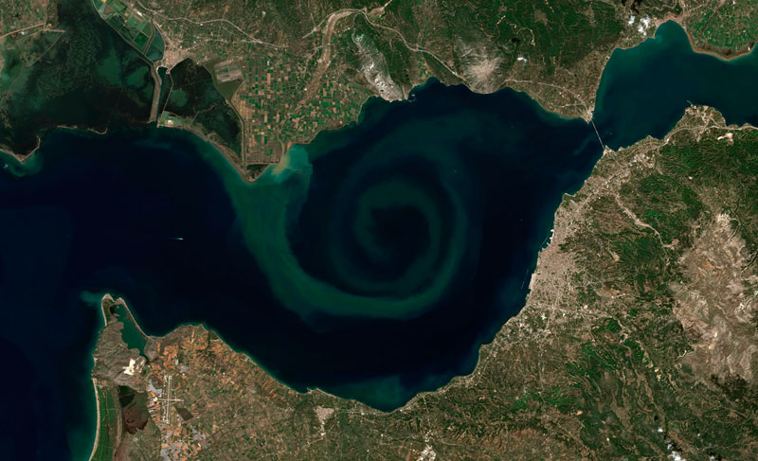
Hypothesis and Objectives
Although photosynthetic organisms are highly affected with seasonal cycles like changes in photoperiod, those rhythmic responses are not characterized using omic techniques yet.
NASA Landsat Image Gallery
Notes:
In fact, seasonal cycles are associated with massive changes in the marine phytoplankton which generates blooms of microalgae that can be observed from outer space.

Slide 72
Hypothesis and Objectives
Although photosynthetic organisms are highly affected with seasonal cycles like changes in photoperiod, those rhythmic responses are not characterized using omic techniques yet.
NASA Landsat Image Gallery
Notes:
Nevertheless, the responses of microalgae to seasonal variations are not characterized using omics techniques yet.

Slide 73
Hypothesis and Objectives
Although photosynthetic organisms are highly affected with seasonal cycles like changes in photoperiod, those rhythmic responses are not characterized using omic techniques yet.
NASA Landsat Image Gallery
Integrative analysis between rhythmic patterns at the transcriptomic, proteomic and physiological levels have not been performed and are expected to shed light on the responses of living organisms to seasonal variations in diel cycles.
Notes:
So, integrative analysis between rhythmic patterns at the transcriptomic, proteomic and physiological levels have not been performed and are expected to shed light on the responses of living organisms to seasonal variations in diel cycles.

Slide 74
Hypothesis and Objectives
Multiomic characterization of the responses to seasonal variations in diel cycles in Ostreococcus tauri.
Notes:
The general objective in this work consists on a multiomic characterization of the responses to seasonal variations in diel cycles in Ostreococcus tauri. This is achieved following these specific objectives:

Slide 75
Hypothesis and Objectives
Multiomic characterization of the responses to seasonal variations in diel cycles in Ostreococcus tauri.
To develop software tools, computational pipelines, and models to enhance systems biology studies in microalgae, with a specific focus on exploring the results presented in this thesis.
Notes:
To develop software tools, computational pipelines, and models to enhance systems biology studies in microalgae, with a specific focus on exploring the results presented in this thesis.

Slide 76
Hypothesis and Objectives
Multiomic characterization of the responses to seasonal variations in diel cycles in Ostreococcus tauri.
To develop software tools, computational pipelines, and models to enhance systems biology studies in microalgae, with a specific focus on exploring the results presented in this thesis.
To characterize transcriptomic seasonal variations during diel cycles and free-running conditions.
Notes:
2. To characterize transcriptomic seasonal variations during diel cycles and free-running conditions.

Slide 77
Hypothesis and Objectives
Multiomic characterization of the responses to seasonal variations in diel cycles in Ostreococcus tauri.
To develop software tools, computational pipelines, and models to enhance systems biology studies in microalgae, with a specific focus on exploring the results presented in this thesis.
To characterize transcriptomic seasonal variations during diel cycles and free-running conditions.
To characterize proteomic seasonal variations during diel cycles and their integration with transcriptomic responses.
Notes:
3. To characterize proteomic seasonal variations during diel cycles and their integration with transcriptomic responses.

Slide 78
Hypothesis and Objectives
Multiomic characterization of the responses to seasonal variations in diel cycles in Ostreococcus tauri.
To develop software tools, computational pipelines, and models to enhance systems biology studies in microalgae, with a specific focus on exploring the results presented in this thesis.
To characterize transcriptomic seasonal variations during diel cycles and free-running conditions.
To characterize proteomic seasonal variations during diel cycles and their integration with transcriptomic responses.
To characterize seasonal variations in some relevant physiological processes during diel cycles and conduct multi-omics integration with transcriptomic and proteomic data.
Notes:
4. To characterize seasonal variations in relevant physiological processes during diel cycles and conduct multi-omics integration with transcriptomic and proteomic data.

Slide 79
Hypothesis and Objectives
Multiomic characterization of the responses to seasonal variations in diel cycles in Ostreococcus tauri.
To develop software tools, computational pipelines, and models to enhance systems biology studies in microalgae, with a specific focus on exploring the results presented in this thesis.
To characterize transcriptomic seasonal variations during diel cycles and free-running conditions.
To characterize proteomic seasonal variations during diel cycles and their integration with transcriptomic responses.
To characterize seasonal variations in some relevant physiological processes during diel cycles and conduct multi-omics integration with transcriptomic and proteomic data.
Chapter 1
Notes:
Each of these specific objectives are approached in the different chapters of this doctoral thesis.
Starting with chapter 1

Slide 80
Chapter 1.
ALGAEFUN with MARACAS, microALGAE FUNctional
enrichment tool for MicroAlgae RnA-seq and Chip-seq AnalysiS
Notes:
where ALGAEFUN with MARACAS is developed, which is a web based tool for the analysis and interpretation of omic data in microalgae.

Slide 81
Chapter 1: ALGAEFUN with MARACAS
Notes:
This tool is developed aiming the establishment of systems biology studies in microalgae, so a wide variety of them is supported

Slide 82
Chapter 1: ALGAEFUN with MARACAS
Ostreococcus tauri
Micromonas pusilla
Bathycoccus prasinos
Coccomyxa subellipsoidea
Chlamydomonas reinhardtii
Volvox carteri
Dunaliella salina
Haematococcus lacustris
Chromochloris zofingiensis
Klebsormidium nitens
Mesoteanium endlicherianum
Spirogloea muscicola
Phaeodactylum tricornutum
Nannochloropsis gaditana
Notes:
In this phylogenetic tree, all the microalgae supported in ALGAEFUN with MARACAS are represented.

Slide 83
Chapter 1: ALGAEFUN with MARACAS
Ostreococcus tauri
Micromonas pusilla
Bathycoccus prasinos
Coccomyxa subellipsoidea
Chlamydomonas reinhardtii
Chlorophyta
Volvox carteri
Dunaliella salina
Haematococcus lacustris
Chromochloris zofingiensis
Klebsormidium nitens
Mesoteanium endlicherianum
Spirogloea muscicola
Phaeodactylum tricornutum
Nannochloropsis gaditana
Notes:
Several microalgae from both groups Chlorophyta, like Ostreococcus or Micromonas,

Slide 84
Chapter 1: ALGAEFUN with MARACAS
Ostreococcus tauri
Micromonas pusilla
Bathycoccus prasinos
Coccomyxa subellipsoidea
Chlamydomonas reinhardtii
Chlorophyta
Volvox carteri
Dunaliella salina
Haematococcus lacustris
Chromochloris zofingiensis
Klebsormidium nitens
Mesoteanium endlicherianum
Charophyta
Spirogloea muscicola
Phaeodactylum tricornutum
Nannochloropsis gaditana
Notes:
and Charophyta, like Klebsormidium and mesotenium are included.

Slide 85
Chapter 1: ALGAEFUN with MARACAS
Ostreococcus tauri
Micromonas pusilla
Bathycoccus prasinos
Coccomyxa subellipsoidea
Chlamydomonas reinhardtii
Chlorophyta
Volvox carteri
Dunaliella salina
Haematococcus lacustris
Chromochloris zofingiensis
Klebsormidium nitens
Mesoteanium endlicherianum
Charophyta
Spirogloea muscicola
Phaeodactylum tricornutum
Stramenopiles
Nannochloropsis gaditana
Notes:
And in addition, two algae from the group Stramenopails, like Phaeodactylum, are also supported by ALGAEFUN with MARACAS. This group that isnot included in the green-lineage, but they are relevant in biotechnology industry

Slide 86
Chapter 1: ALGAEFUN with MARACAS
Ostreococcus tauri
Basic Biological Sciences
Micromonas pusilla
Bathycoccus prasinos
Coccomyxa subellipsoidea
Chlamydomonas reinhardtii
Chlorophyta
Volvox carteri
Dunaliella salina
Haematococcus lacustris
Chromochloris zofingiensis
Klebsormidium nitens
Mesoteanium endlicherianum
Charophyta
Spirogloea muscicola
Phaeodactylum tricornutum
Stramenopiles
Nannochloropsis gaditana
Notes:
In fact, in this list of microalgae there is a balanced representation of algae mainly used in basic biological science, like Chlamydomonas

Slide 87
Chapter 1: ALGAEFUN with MARACAS
Ostreococcus tauri
Basic Biological Sciences
Biotechnology
Micromonas pusilla
Bathycoccus prasinos
Coccomyxa subellipsoidea
Chlamydomonas reinhardtii
Chlorophyta
Volvox carteri
Dunaliella salina
Haematococcus lacustris
Chromochloris zofingiensis
Klebsormidium nitens
Mesoteanium endlicherianum
Charophyta
Spirogloea muscicola
Phaeodactylum tricornutum
Stramenopiles
Nannochloropsis gaditana
Notes:
as well as biotechnology, like Haematococcus.

Slide 88
Chapter 1: ALGAEFUN with MARACAS
ALGAEFUN with MARACAS a web based tool that consists in two different functions:
Notes:
Now I will simplify the implementation of ALGAEFUN with MARACAS in order to bring a simple picture of how it works.

Slide 89
Chapter 1: ALGAEFUN with MARACAS
ALGAEFUN with MARACAS a web based tool that consists in two different functions:
MARACAS (MicroAlgae RnA-seq and Chip-seq AnalysiS)
can analyse ChIP-seq (epigenetics) and RNA-seq (transcriptomics) raw sequencing
Notes:
ALGAEFUN with MARACAS is a web based tool that consists in two different functions: First, MARACAS which stands for MicroAlgae RnA-seq and Chip-seq AnalysiS

Slide 90
Chapter 1: ALGAEFUN with MARACAS
ALGAEFUN with MARACAS a web based tool that consists in two different functions:
MARACAS (MicroAlgae RnA-seq and Chip-seq AnalysiS)
can analyse ChIP-seq (epigenetics) and RNA-seq (transcriptomics) raw sequencing
MARACAS
RNA-seq pipeline
ChIP-seq pipeline
Notes:
MARACAS implements a fully automatic computational pipeline to analyse

Slide 91
Chapter 1: ALGAEFUN with MARACAS
ALGAEFUN with MARACAS a web based tool that consists in two different functions:
MARACAS (MicroAlgae RnA-seq and Chip-seq AnalysiS)
can analyse ChIP-seq (epigenetics) and RNA-seq (transcriptomics) raw sequencing
MARACAS
RNA-seq pipeline
Raw sequencing data from
RNA-seq or
ChIP-seq
ChIP-seq pipeline
Notes:
raw sequencing data from RNA-seq and CHIP-seq studies in microalgae.

Slide 92
Chapter 1: ALGAEFUN with MARACAS
ALGAEFUN with MARACAS a web based tool that consists in two different functions:
MARACAS (MicroAlgae RnA-seq and Chip-seq AnalysiS)
can analyse ChIP-seq (epigenetics) and RNA-seq (transcriptomics) raw sequencing
MARACAS
RNA-seq pipeline
List of differentially expressed genes
Raw sequencing data from
RNA-seq or
ChIP-seq
ChIP-seq pipeline
Notes:
As a result, MARACAS generates a set of differentially expressed genes in RNA-seq pipeline

Slide 93
Chapter 1: ALGAEFUN with MARACAS
ALGAEFUN with MARACAS a web based tool that consists in two different functions:
MARACAS (MicroAlgae RnA-seq and Chip-seq AnalysiS)
can analyse ChIP-seq (epigenetics) and RNA-seq (transcriptomics) raw sequencing
MARACAS
RNA-seq pipeline
List of differentially expressed genes
Raw sequencing data from
RNA-seq or
ChIP-seq
ChIP-seq pipeline
List of
genomic loci
Notes:
or the list of genomic loci in the ChIP-seq pipeline

Slide 94
Chapter 1: ALGAEFUN with MARACAS
ALGAEFUN with MARACAS a web based tool that consists in two different functions:
ALGAEFUN (microALGAE FUNctional enrichment tool)
can execute functional annotation analysis of gene sets and annotation analysis of genomic loci
MARACAS
ALGAEFUN
RNA-seq pipeline
Functional annotation analysis of gene sets
List of differentially expressed genes
Raw sequencing data from
RNA-seq or
ChIP-seq
ChIP-seq pipeline
Annotation analysis of genomic loci
List of
genomic loci
Notes:
and they can be further analyzed using the second tool, ALGAEFUN which stands for microAlgae FUNctional enrichment tool.

Slide 95
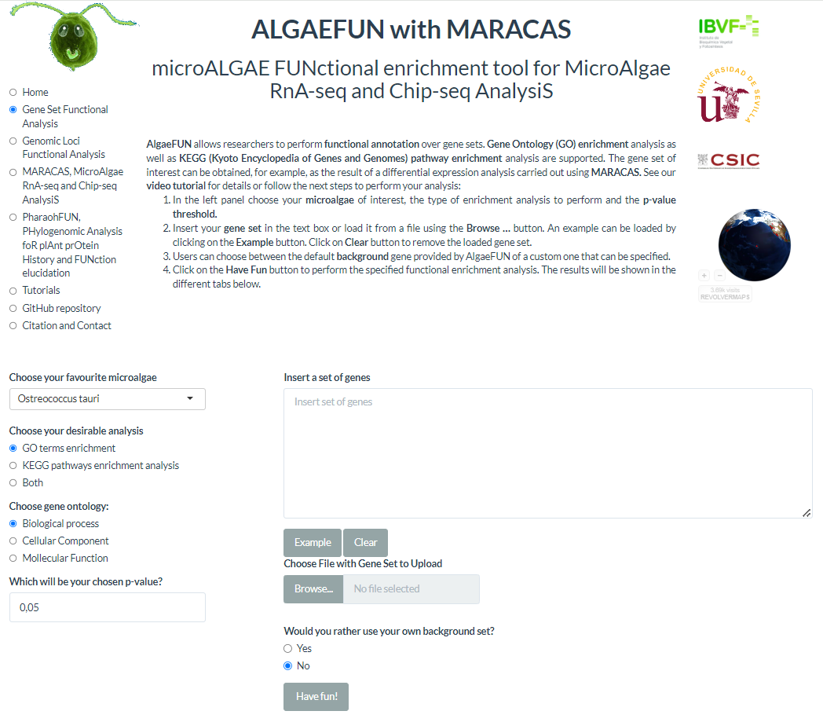
Chapter 1: ALGAEFUN with MARACAS
ALGAEFUN
List of differentially expressed genes
Functional annotation analysis of gene sets
Annotation analysis of genomic loci
List of
genomic loci
Notes:
This is how the web of ALGAEFUN looks like. In that web the user can input the desired settings of the analysis, like the microalgae of interest and the type of analysis and introduce the data needed to carry out the analysis. The results are also displayed in this web.

Slide 96
Chapter 1: ALGAEFUN with MARACAS
ALGAEFUN
RNA-seq
GO enrichment
List of differentially expressed genes
Functional annotation analysis of gene sets
ChIP-seq
Annotation analysis of genomic loci
List of
genomic loci
Notes:
When ALGAEFUN receives the results from an RNA-seq analysis, the differentially expressed set of genes are functionally annotated by performing two kind of functional enrichment analysis: First, Gene Ontology (GO) enrichment.

Slide 97
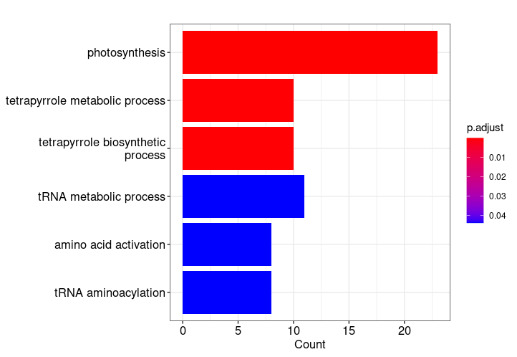
Chapter 1: ALGAEFUN with MARACAS
ALGAEFUN
List of differentially expressed genes
Functional annotation analysis of gene sets
Annotation analysis of genomic loci
List of
genomic loci
Notes:
The results from this analysis are represented in several ways by ALGAEFUN, and one of them is this barplot

Slide 98
Chapter 1: ALGAEFUN with MARACAS
ALGAEFUN
List of differentially expressed genes
Functional annotation analysis of gene sets
Annotation analysis of genomic loci
List of
genomic loci
Notes:
where the biological processes that are found to be enriched in this set of genes

Slide 99
Chapter 1: ALGAEFUN with MARACAS
ALGAEFUN
List of differentially expressed genes
Functional annotation analysis of gene sets
Annotation analysis of genomic loci
List of
genomic loci
Notes:
Along with their significance level of the results using different colors.

Slide 100
Chapter 1: ALGAEFUN with MARACAS
ALGAEFUN
GO enrichment
List of differentially expressed genes
Functional annotation analysis of gene sets
Metabolic pathway enrichment
Annotation analysis of genomic loci
List of
genomic loci
Notes:
And the user can also choose to execute a metabolic pathway enrichment

Slide 101
Chapter 1: ALGAEFUN with MARACAS
ALGAEFUN
GO enrichment
List of differentially expressed genes
Functional annotation analysis of gene sets
Metabolic pathway enrichment
Annotation analysis of genomic loci
List of
genomic loci
metabolic pathways enriched in the set of genes are identified
Notes:
As a result, metabolic pathways enriched in this set of genes are identified

Slide 102
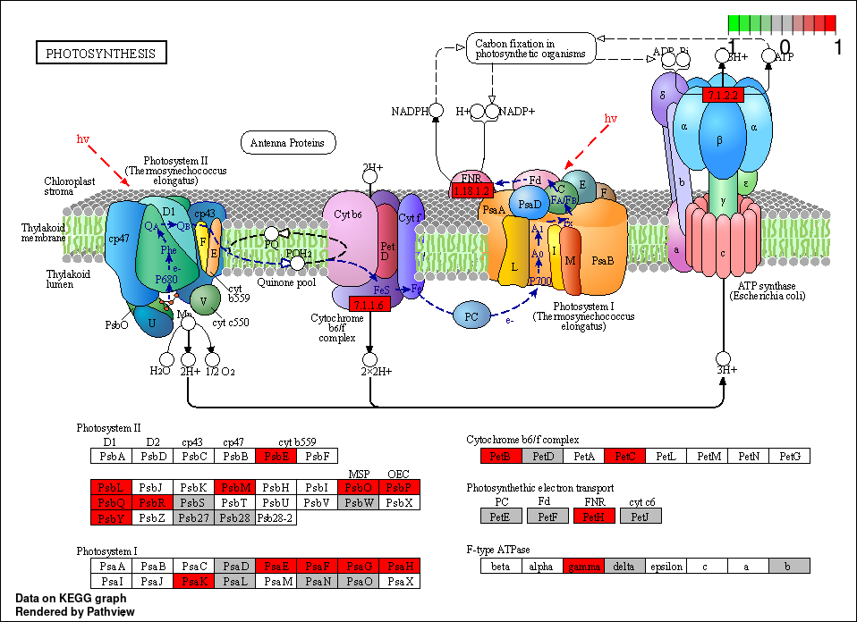
Chapter 1: ALGAEFUN with MARACAS
ALGAEFUN
List of differentially expressed genes
Functional annotation analysis of gene sets
Annotation analysis of genomic loci
List of
genomic loci
Notes:
and can be represented, like the example that you can see here with photosynthesis.

Slide 103
Chapter 1: ALGAEFUN with MARACAS
ALGAEFUN
List of differentially expressed genes
Functional annotation analysis of gene sets
Annotation analysis of genomic loci
List of
genomic loci
Notes:
An esquematic representation of the metabolic pathway is included

Slide 104
Chapter 1: ALGAEFUN with MARACAS
ALGAEFUN
List of differentially expressed genes
Functional annotation analysis of gene sets
Annotation analysis of genomic loci
List of
genomic loci
Notes:
along with the list of genes that are involved in this pathway highliting in red color the ones that are present in your set of genes.

Slide 105
Chapter 1: ALGAEFUN with MARACAS
ALGAEFUN
List of differentially expressed genes
Functional annotation analysis of gene sets
Annotation analysis of genomic loci
List of
genomic loci
Set of potential target genes
Notes:
Apart from that, ALGAEFUN can also analyse a list of genomic loci from a ChIP-seq analysis, generating for example, a set of potential target genes

Slide 106
Chapter 1: ALGAEFUN with MARACAS
ALGAEFUN
List of differentially expressed genes
Functional annotation analysis of gene sets
Annotation analysis of genomic loci
Distribution of loci over gene features
List of
genomic loci
Set of potential target genes
Notes:
It can also analyse the distribution of the genomic loci over gene features.

Slide 107
Chapter 1: ALGAEFUN with MARACAS
Promoter
5’ UTR
3’ UTR
1st exon
Other exon
1st intron
Other intron
Downstream
Distal intergenic
ALGAEFUN
List of differentially expressed genes
Functional annotation analysis of gene sets
Annotation analysis of genomic loci
Distribution of loci over gene features
List of
genomic loci
Set of potential target genes
Notes:
These results are represented in pie plots, like the one that you can see here, where the most of the genomic loci correspond to promoter sites..

Slide 108
Chapter 1: ALGAEFUN with MARACAS
Promoter
5’ UTR
3’ UTR
1st exon
Other exon
1st intron
Other intron
Downstream
Distal intergenic
ALGAEFUN
List of differentially expressed genes
Functional annotation analysis of gene sets
Annotation analysis of genomic loci
Distribution of loci over gene features
List of
genomic loci
Set of potential target genes
Identification of DNA motifs
Notes:
Also ALGAEFUN can identify of DNA motifs in the list of genomic loci.

Slide 109
Chapter 1: ALGAEFUN with MARACAS
Promoter
5’ UTR
3’ UTR
1st exon
Other exon
1st intron
Other intron
Downstream
Distal intergenic
ALGAEFUN
List of differentially expressed genes
Functional annotation analysis of gene sets
Annotation analysis of genomic loci
Distribution of loci
List of
genomic loci
Set of potential target genes
Identification of DNA motifs
Notes:
This analysis generate plots like this one

Slide 110
Chapter 1: ALGAEFUN with MARACAS
Promoter
5’ UTR
3’ UTR
1st exon
Other exon
1st intron
Other intron
Downstream
Distal intergenic
ALGAEFUN
List of differentially expressed genes
Functional annotation analysis of gene sets
Annotation analysis of genomic loci
Distribution of loci
List of
genomic loci
Set of potential target genes
Identification of DNA motifs
Notes:
where genes features like promoter

Slide 111
Chapter 1: ALGAEFUN with MARACAS
Promoter
5’ UTR
3’ UTR
1st exon
Other exon
1st intron
Other intron
Downstream
Distal intergenic
ALGAEFUN
List of differentially expressed genes
Functional annotation analysis of gene sets
Annotation analysis of genomic loci
Distribution of loci
List of
genomic loci
Set of potential target genes
Identification of DNA motifs
Notes:
and exons are represented,

Slide 112
Chapter 1: ALGAEFUN with MARACAS
Promoter
5’ UTR
3’ UTR
1st exon
Other exon
1st intron
Other intron
Downstream
Distal intergenic
ALGAEFUN
List of differentially expressed genes
Functional annotation analysis of gene sets
Tanscription factor binding site
Annotation analysis of genomic loci
Distribution of loci
List of
genomic loci
Set of potential target genes
Identification of DNA motifs
Notes:
and you can see the peaks corresponding to the transcription factor binding in the promoter area.

Slide 113
Chapter 1: ALGAEFUN with MARACAS
Promoter
5’ UTR
3’ UTR
1st exon
Other exon
1st intrón
Other intrón
Downstream
Distal intergenic
ALGAEFUN
List of differentially expressed genes
Functional annotation analysis of gene sets
G-box: CACGTC
Annotation analysis of genomic loci
Distribution of loci
List of
genomic loci
Set of potential target genes
Identification of DNA motifs
Notes:
With this, ALGAEFUN search for DNA motifs in the binding site and here a common one like the Gbox is detected.

Slide 114
Chapter 1: ALGAEFUN with MARACAS
Notes:
Compared to the limited number of already existing tools for systems biology in microalgae,

Slide 115
Chapter 1: ALGAEFUN with MARACAS
Notes:
ALGAEFUN with MARACAS implements several novel functionalities

Slide 116
Chapter 1: ALGAEFUN with MARACAS
The first tool implementing analysis of raw sequencing data from RNA-seq and ChIP-seq including the annotation of results.
Notes:
And it’s the first one in implementing RNA-seq and ChipSeq analysis from raw sequencing data to the annotation of results

Slide 117
Chapter 1: ALGAEFUN with MARACAS
ALGAEFUN with MARACAS improves and implements several novel functionalities that are currently used in a daily basis by numerous research groups, saving time, effort and even money to researchers with limited experience in analysing omic data.
Notes:
Overall, as it has been discussed, ALGAEFUN with MARACAS improves and implements several novel functionalities that currently are used in a daily basis by numerous research groups, saving time, effort and even money to researchers with limited experience in analysing omic data.

Slide 118

Hypothesis and Objectives
Multiomic characterization of the responses to seasonal variations in diel cycles in Ostreococcus tauri.
To develop software tools, computational pipelines, and models to enhance systems biology studies in microalgae, with a specific focus on exploring the results presented in this thesis.
To characterize transcriptomic seasonal variations during diel cycles and free-running conditions.
To characterize proteomic seasonal variations during diel cycles and their integration with transcriptomic responses.
To characterize seasonal variations in relevant physiological processes during diel cycles and conduct multi-omics integration with transcriptomic and proteomic data.
Same
experimental
design
Notes:
With the first objective completed, the next chapters can be presented. But before moving on to the next results, I will describe the experimental design that has been followed.

Slide 119
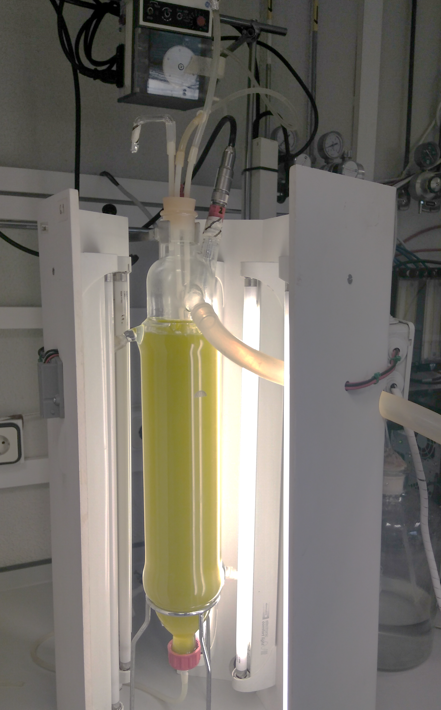
Experimental design
Based on fully automated continuous culture systems where summer long days (LD) and winter short days (SD) are simulated.
1.8 L photochemostats
Peristaltic
pump
Temperature/pH Probe
Overflow tube
Light panels
Air input
Notes:
We used continuous culture performed in 2L photochemostats with all culture conditions, like Temperature, pH or light constantly measured and computationally controlled.

Slide 120
Experimental design
Based on fully automated continuous culture systems where summer long days (LD) and winter short days (SD) are simulated.
Summer long day
(16h light / 8h dark)
Notes:
In order to study seasonal changes, the two extreme photoperiods were simulated using this culture systems. That is, long days of summer

Slide 121
Experimental design
Based on fully automated continuous culture systems where summer long days (LD) and winter short days (SD) are simulated.
Summer long day
(16h light / 8h dark)
Notes:
with 16h of light

Slide 122
Experimental design
Based on fully automated continuous culture systems where summer long days (LD) and winter short days (SD) are simulated.
Summer long day
(16h light / 8h dark)
Notes:
In order to study seasonal changes, the two extreme photoperiods were simulated using this culture systems. That is, long days of summer with 16h of light and 8h of dark

Slide 123
Experimental design
Based on fully automated continuous culture systems where summer long days (LD) and winter short days (SD) are simulated.
Summer long day
(16h light / 8h dark)
Summer long day
(16h light / 8h dark)
Winter short day
(8h light / 16h dark)
Notes:
and short days of winter

Slide 124
Experimental design
Based on fully automated continuous culture systems where summer long days (LD) and winter short days (SD) are simulated.
Summer long day
(16h light / 8h dark)
Summer long day
(16h light / 8h dark)
Winter short day
(8h light / 16h dark)
Notes:
and short days of winter with 8h of light

Slide 125
Experimental design
Based on fully automated continuous culture systems where summer long days (LD) and winter short days (SD) are simulated.
Summer long day
(16h light / 8h dark)
Summer long day
(16h light / 8h dark)
Winter short day
(8h light / 16h dark)
Notes:
And 16h of dark.

Slide 126
Experimental design
Based on fully automated continuous culture systems where summer long days (LD) and winter short days (SD) are simulated.
Summer long day
(16h light / 8h dark)
Summer long day
(16h light / 8h dark)
Winter short day
(8h light / 16h dark)
Notes:
Lights were gradually increased and decreased during the day simulating natural photoperiods.

Slide 127
Experimental design
Based on fully automated continuous culture systems where summer long days (LD) and winter short days (SD) are simulated.
Summer long day
(16h light / 8h dark)
Winter short day
(8h light / 16h dark)
Notes:
The experimental design consisted of three consecutive days under each photoperiod

Slide 128
Experimental design
Based on fully automated continuous culture systems where summer long days (LD) and winter short days (SD) are simulated.
Summer long day
(16h light / 8h dark)
Winter short day
(8h light / 16h dark)
Samples taken every 4h
Notes:
and samples were taken every 4 h during those days.

Slide 129
Experimental design
Based on fully automated continuous culture systems where summer long days (LD) and winter short days (SD) are simulated.
Summer long day
(16h light / 8h dark)
Winter short day
(8h light / 16h dark)
ZT = Zeitgeber Time
Samples taken every 4h
Notes:
Each day starts at ze te zero, because time is expressed in Zeitgeber Time (ZT) where ZT0 correspond to dawn, ZT4 to 4 h after dawn and so on

Slide 130
Experimental design
Based on fully automated continuous culture systems where summer long days (LD) and winter short days (SD) are simulated.
Summer long day
(16h light / 8h dark)
Harvested every 4h
For 3 consecutive
days
Transcriptomic analysis
(RNA-seq)
Proteomic analysis
(SWATH-MS)
Physiological data:
Flow cytometry
Pulse amplitude modulation
Analytical method
Enzyme assays
Winter short day
(8h light / 16h dark)
ZT = Zeitgeber Time
Samples taken every 4h
Notes:
This 36 samples were used for transcriptomic analysis, proteomic analysis, and for the generation of physiological data from Flow cytometry, pulse amplitude modulation, analytical methods and enzyme assays

Slide 131
Experimental design
Summer long day (LD)
(16h light / 8h dark)
Summer long day
(16h light / 8h dark)
Identification of bona fide circadian genes in transcriptomic data
Winter short day (SD)
(8h light / 16h dark)
Free-running conditions
Notes:
In addition free-running conditions were also considered for the transcriptomic analysis in order to identify bona fide circadian genes. Those are the ones presenting rhythmic expression profiles under both LD and SD as well as maintaining their rhythmic expression profiles under free-running

Slide 132
Experimental design
Identification of bona fide circadian genes in transcriptomic data
Summer long day (LD)
(16h light / 8h dark)
Free-running conditions
Summer long day
(16h light / 8h dark)
Winter short day (SD)
(8h light / 16h dark)
Notes:
so three days of free-running conditions (constant light

Slide 133
Experimental design
Identification of bona fide circadian genes in transcriptomic data
Summer long day (LD)
(16h light / 8h dark)
Free-running conditions
Summer long day
(16h light / 8h dark)
Winter short day (SD)
(8h light / 16h dark)
Notes:
or constant dark) are also included in the experimental design of the transcriptomic analysis.

Slide 134
Experimental design
Identification of bona fide circadian genes in transcriptomic data
Summer long day (LD)
(16h light / 8h dark)
Free-running conditions
Summer long day
(16h light / 8h dark)
Winter short day (SD)
(8h light / 16h dark)
Notes:
No samples were collected during the first day to allow culture acclimation, and samples were collected during two consecutive days every 4 h starting at CT0, Circadian Time 0, the time point corresponding to subjective dawn. The results generated following this experimental design are presented in the following chapters 2:

Slide 135
Experimental design
Identification of bona fide circadian genes in transcriptomic data
Summer long day (LD)
(16h light / 8h dark)
Free-running conditions
Summer long day
(16h light / 8h dark)
Winter short day (SD)
(8h light / 16h dark)
Notes:
and samples were collected during two consecutive days every 4 h starting at CT0, Circadian Time 0, the time point corresponding to subjective dawn. The results generated following this experimental design are presented in the following chapters 2:

Slide 136
Experimental design
Identification of bona fide circadian genes in transcriptomic data
Summer long day (LD)
(16h light / 8h dark)
Free-running conditions
Summer long day
(16h light / 8h dark)
Winter short day (SD)
(8h light / 16h dark)
CT = Circadian Time
Notes:
starting at CT0, Circadian Time 0, the time point corresponding to subjective dawn. The results generated following this experimental design are presented in the next chapter:

Slide 137
Chapter 2.
Transcriptomic analysis of diel and seasonal cycles in
Ostreococcus tauri
Notes:
called: Transcriptomic analysis of diel and seasonal cycles in Ostreococcus tauri

Slide 138

Chapter 2: Transcriptomic analysis
Non-parametric methods
(RAIN, R package)
Identify significant diel rhythms
=24h in diel cycles
Notes:
Applying non-parametric methods implemented in the R package RAIN are used to identify significant diel rhythms with 24h period over the transcriptome.

Slide 139
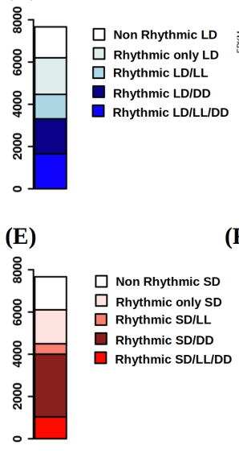
Chapter 2: Transcriptomic analysis
LD
Number of genes
80% of the transcriptome is rhythmic
Notes:
Specifically, 80 % of the entire Ostreococcus transcriptome is rhythmic under long day.

Slide 140
Chapter 2: Transcriptomic analysis
LD
Number of genes
80% of the transcriptome is rhythmic
SD
Number of genes
80% of the transcriptome is rhythmic
Notes:
And a similar percentage is found to be rhythmic under short day

Slide 141
Chapter 2: Transcriptomic analysis
LD
Rhythmic transcripts in
LD
6201
Number of genes
80% of the transcriptome is rhythmic
SD
Number of genes
80% of the transcriptome is rhythmic
Notes:
In fact, when the rhythmic transcriptomes under each photoperiod are compared

Slide 142
Chapter 2: Transcriptomic analysis
LD
Rhythmic transcripts in
LD
Rhythmic transcripts in
SD
Number of genes
80% of the transcriptome is rhythmic
929
5272
SD
832
Number of genes
80% of the transcriptome is rhythmic
Notes:
it can be observed that the sets of rhythmic genes under LD and SD entrainment are almost coincident

Slide 143
Chapter 2: Transcriptomic analysis
LD
Rhythmic transcripts in
Rhythmic transcripts in
Number of genes
Almost the complete transcriptome of Ostreococcus tauri is rhythmic under long day (LD) and short day (SD) and rhythmic genes under both photoperiod are almost identical.
80% of the transcriptome is rhythmic
SD
Number of genes
80% of the transcriptome is rhythmic
Notes:
Showing that…Almost the complete transcriptome of Ostreooccus tauri is rhythmic under long day (LD) and short day (SD) and rhythmic genes under both photoperiod are almost coincident.
PREGUNTA: que genes no coinciden?

Slide 144
Chapter 2: Transcriptomic analysis
LD
LD
20% of the transcriptome present not self-sustained rhythms
Number of genes
Number of genes
SD
Number of genes
20% of the transcriptome present not self-sustained rhythms
Notes:
However, around 20 % of the transcriptome under both LD and SD loose rhythmiticty under free-running conditions. Suggesting that this genes are completely reliant on light/dark cycles.

Slide 145
Chapter 2: Transcriptomic analysis
LD
LD
20% of the transcriptome present not self-sustained rhythms
Number of genes
Number of genes
Reliant on light-dark cycles
Responding to rhythmic signals
SD
Number of genes
20% of the transcriptome present not self-sustained rhythms
Notes:
Suggesting that this genes are completely reliant on light/dark cycles and the rhythmicity observed under long day and short day were just a response to rhythmic signals.

Slide 146
Chapter 2: Transcriptomic analysis
LD
LD
LD
Number of genes
15% of the LD transcriptome present rhythmic expression profiles in LL
Number of genes
Number of genes
SD
SD
Number of genes
6% of the SD transcriptome present rhythmic expression profiles in LL
Number of genes
Notes:
Apart from that, genes maintaining its rhythmic expression profile under constant light after LD entrainment correspond to 15% of the transcriptome
whereas only 6% do after SD entrainment.

Slide 147
Chapter 2: Transcriptomic analysis
LD
LD
LD
Number of genes
15% of the LD transcriptome present rhythmic expression profiles in LL
Number of genes
Number of genes
SD
Proportions dependent on previous photoperiod of entrainment
SD
Number of genes
6% of the SD transcriptome present rhythmic expression profiles in LL
Number of genes
Notes:
This suggests that the transcriptome proportion maintaining its rhythmic profile under the different free running conditions is found to be dependent on the previous photoperiod of entrainment.

Slide 148
Chapter 2: Transcriptomic analysis
Polymerase A
LD
Constant light
LD
LD
Number of genes
Number of genes
Number of genes
SD
SD
Constant dark
Number of genes
Number of genes
Notes:
One of the genes presenting this gene expression profile is the one encoding the polymerase A

Slide 149
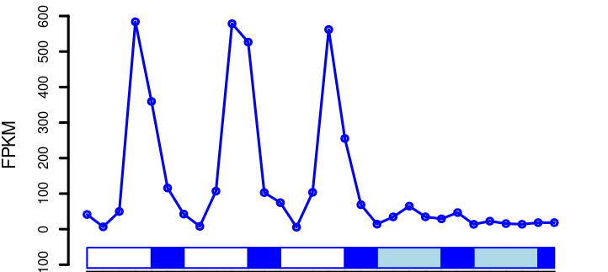
Chapter 2: Transcriptomic analysis
Polymerase A
LD
Constant light
LD
LD
Number of genes
Number of genes
Number of genes
SD
SD
Constant dark
Number of genes
Number of genes
Notes:
That mantains its rhythmicity under constant light

Slide 150
Chapter 2: Transcriptomic analysis
Polymerase A
LD
Constant light
LD
LD
Number of genes
Number of genes
Number of genes
SD
SD
Constant dark
Number of genes
Number of genes
Notes:
But its expression seems to be repressed by constant dark

Slide 151
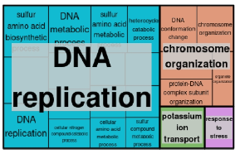
Chapter 2: Transcriptomic analysis
Polymerase A
LD
Constant light
LD
LD
Number of genes
Number of genes
Number of genes
SD
SD
Constant dark
Number of genes
Number of genes
Biological processes enriched in set of rhythmic genes under constant light (LL)
Notes:
But there are more gene expression profiles with this behaviour, and some of the enriched biological processes that can be found among them are DNA replication and choromosome organization

Slide 152
Chapter 2: Transcriptomic analysis
LD
LD
LD
Number of genes
Number of genes
22% of the LD transcriptome present rhythmic expression profiles in DD
Number of genes
SD
SD
Number of genes
Number of genes
Notes:
In addition, after LD entrainment the 22% of the transcriptome maintain their rhythmicity under constant dark,

Slide 153
Chapter 2: Transcriptomic analysis
LD
LD
LD
Number of genes
Number of genes
22% of the LD transcriptome present rhythmic expression profiles in DD
Number of genes
SD
SD
Number of genes
Number of genes
39% of the SD transcriptome present rhythmic expression profiles in DD
Notes:
and this proportion increase to almost 40% after SD entrainment, suggesting that constant light has a detrimental effect over the rhythmicity of the transcriptome.

Slide 154
Chapter 2: Transcriptomic analysis
LD
LD
LD
Number of genes
Number of genes
22% of the LD transcriptome present rhythmic expression profiles in DD
Number of genes
SD
Constant dark has a lower detrimental effect over rhythmicity than constant light
SD
Number of genes
Number of genes
39% of the SD transcriptome present rhythmic expression profiles in DD
Notes:
suggesting that constant dark has a lower detrimental effect over the rhythmicity of the transcriptome, compared to constant light.

Slide 155
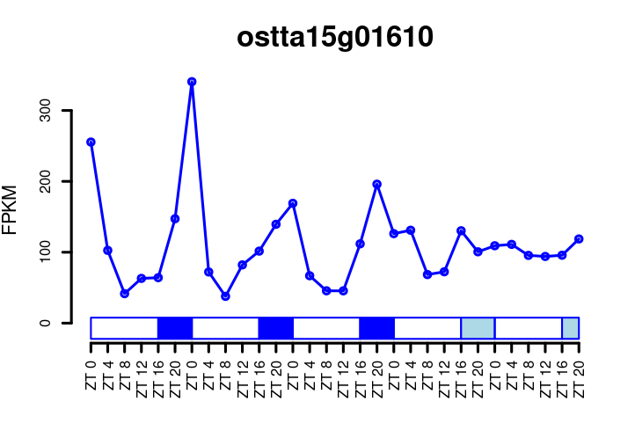
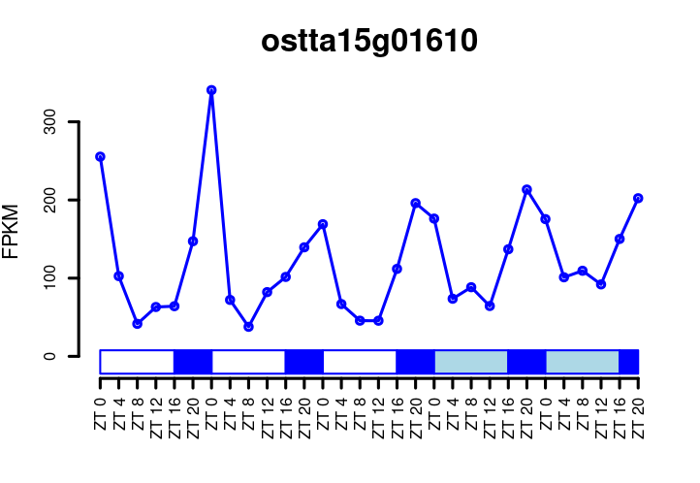
Chapter 2: Transcriptomic analysis
Ribosomal biogenesis regulatory protein
LD
Constant light
Number of genes
SD
SD
Constant dark
Number of genes
Notes:
One of the genes presenting this gene expression profile is the one encoding a ribosomal biogenesis protein

Slide 156
Chapter 2: Transcriptomic analysis
Ribosomal biogenesis regulatory protein
LD
Constant light
Number of genes
SD
SD
Constant dark
Number of genes
Notes:
That doesn’t maintain its rhythmic expression profile under constant light but

Slide 157
Chapter 2: Transcriptomic analysis
Ribosomal biogenesis regulatory protein
LD
Constant light
Number of genes
SD
SD
Constant dark
Number of genes
Notes:
It does under constant dark

Slide 158
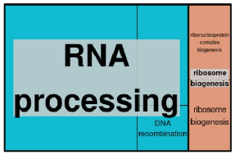
Chapter 2: Transcriptomic analysis
Ribosomal biogenesis regulatory protein
LD
Constant light
Biological processes enriched in set of rhythmic genes under constant dark (DD)
Number of genes
SD
SD
Constant dark
Number of genes
Notes:
suggesting that constant dark has a lower detrimental effect over the rhythmicity of the transcriptome, compared to constant light.

Slide 159
Chapter 2: Transcriptomic analysis
Ribosomal biogenesis regulatory protein
LD
Constant light
Biological processes enriched in set of rhythmic genes under constant dark (DD)
Number of genes
SD
SD
Constant dark
Number of genes
Notes:
But there are more gene expression profiles with this behaviour, and some of the enriched biological processes that can be found among them are RNA processing and Ribosome biogenesis

Slide 160
Chapter 2: Transcriptomic analysis
Ribosomal biogenesis regulatory protein
LD
Constant light
Biological processes enriched in set of rhythmic genes under constant dark (DD)
Number of genes
The set of genes that only maintain their rhythmicity under one of the two free-running conditions are proposed to be only partially regulated by the circadian clock and present complex regulatory systems where other mechanisms are involved.
SD
SD
Constant dark
Number of genes
Notes:
This could suggest that the set of genes that only maintain their rhythmicity under one of the two free-running conditions are proposed to be only partially regulated by the circadian clock and present complex regulatory systems where other mechanisms are involved.

Slide 161
Chapter 2: Transcriptomic analysis
Identification of bona fide circadian genes.
LD
LD
LD
LD
LD
Number of genes
LD
Number of genes
Number of genes
Number of genes
Number of genes
20% of the LD transcriptome present rhythmic expression profiles in both DD and LL
1647
SD
Number of genes
Notes:
And finally, to identify bona fide circadian genes the 20% of the transcriptome presenting rhythmic expression profile under both LL and DD after LD entrainment

Slide 162
Chapter 2: Transcriptomic analysis
Identification of bona fide circadian genes.
LD
LD
LD
LD
LD
LD
Number of genes
Number of genes
LD
Number of genes
Number of genes
Number of genes
Number of genes
20% of the LD transcriptome present rhythmic expression profiles in both DD and LL
SD
SD
SD
1297
350
684
Number of genes
Number of genes
13% of the SD transcriptome present rhythmic expression profiles in both DD and LL
Notes:
are compared with the 13% found after SD entrainment. CAMBIAR AZUL DE DD-LL

Slide 163
Chapter 2: Transcriptomic analysis
Identification of bona fide circadian genes.
LD
4.6% of the transcriptome are bona fide circadian genes
LD
LD
LD
LD
LD
Number of genes
Number of genes
LD
Number of genes
Number of genes
Number of genes
Number of genes
20% of the LD transcriptome present rhythmic expression profiles in both DD and LL
SD
SD
SD
1297
350
684
Number of genes
Number of genes
13% of the SD transcriptome present rhythmic expression profiles in both DD and LL
Notes:
In that way, 350 genes, corresponding to 4.6% of the transcriptome, are identified as bona fide circadian genes.

Slide 164
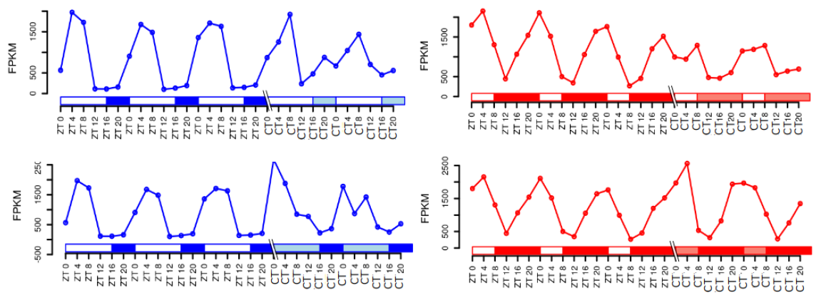
Chapter 2: Transcriptomic analysis
Identification of bona fide circadian genes.
LD
RuBisCo
activase
SD
Notes:
The rubisco activase is an example of bona fide circadian gene, which present a clear rhythmic expression profile under both LD and SD

Slide 165
Chapter 2: Transcriptomic analysis
Identification of bona fide circadian genes.
LD
RuBisCo
activase
SD
Notes:
and maintain that rhythmic profile under both costant light

Slide 166
Chapter 2: Transcriptomic analysis
Identification of bona fide circadian genes.
LD
RuBisCo
activase
SD
Notes:
And constant dark

Slide 167
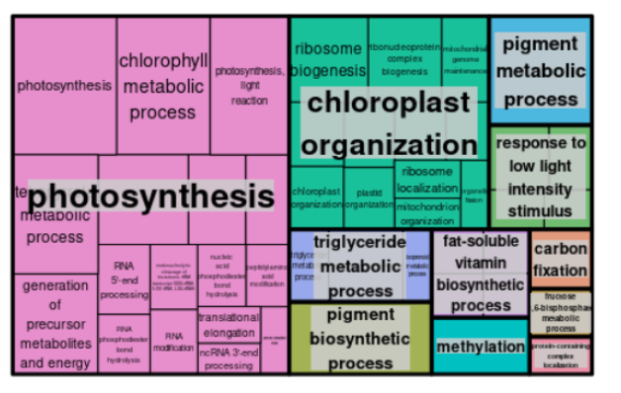
Chapter 2: Transcriptomic analysis
Identification of bona fide circadian genes.
LD
RuBisCo
activase
SD
Notes:
Apart from the Rubisco Activase, in Ostreococcus, this particular set of genes are involved in biological processes like photosynthesis, chloroplast organization and pigment metabolism.

Slide 168
Chapter 2: Transcriptomic analysis
Identification of bona fide circadian genes.
The expression of 350 genes involved in processes such as photosynthesis, chloroplast organization and pigment metabolism, are identified as bona fide circadian genes and, thus, are proposed to be purely regulated by the circadian clock.
LD
RuBisCo
activase
SD
Notes:
So, the expression of the 350 genes involved in those processes are identified as bona fide circadian genes and consequently are proposed to be purely regulated by the circadian clock.

Slide 169
Chapter 2: Transcriptomic analysis
Changes in the transcriptome caused by seasonal cycles
Parametric methods
(Circacompare, R package)
Identify significant differences between rhythmic gene expression profiles under both photoperiod
Notes:
Then parametric methods implemented in Circacompare were used to find differences between short day and long day transcriptomes, and we find that seasons have a clear effect over the gene expression profiles in O. tauri

Slide 170
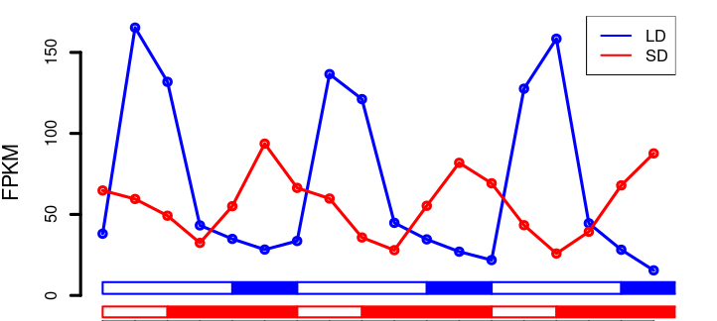
Chapter 2: Transcriptomic analysis
Changes in the transcriptome caused by seasonal cycles
Notes:
Here we can see the expression profile of a rhythmic gene under three short days (in red) and three long days in blue as an example

Slide 171
Chapter 2: Transcriptomic analysis
Changes in the transcriptome caused by seasonal cycles
Notes:
Here it can be observed how amplitudes, the maximum level of expression, is reduced in SD.

Slide 172
Chapter 2: Transcriptomic analysis
Changes in the transcriptome caused by seasonal cycles
Notes:
And also, the time where the maximum level of expression takes place is shifted from one season to another.

Slide 173
Chapter 2: Transcriptomic analysis
Changes in the transcriptome caused by seasonal cycles
Predicts amplitude reductions and phase shifts in gene expression profiles in other seasons
Predictive model entrained with transcriptomic data
Notes:
With this data a predictive model has been entrained to predict the changes in amplitude and phase in gene expression profiles over the year, which is illustrated in this video.

Slide 174
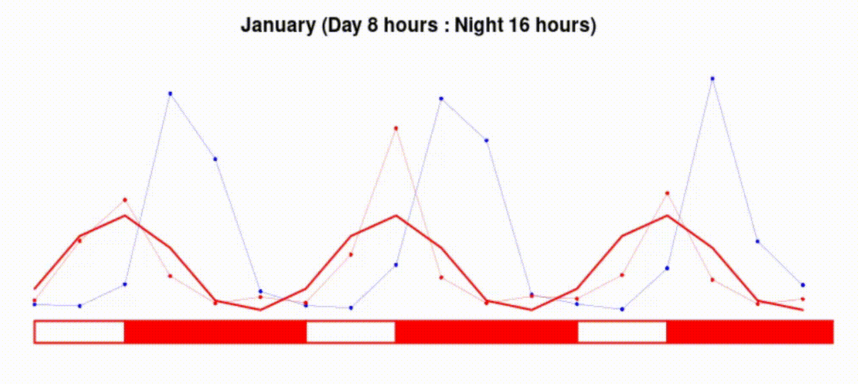
Chapter 2: Transcriptomic analysis
Changes in the transcriptome caused by seasonal cycles
Prediction of changes in amplitude and phase of gene expression profiles over the year
Notes:
The expression profile of a gene under short day conditions is represented in red and long day condition in blue. A wider line changing in color represents our prediction of how amplitude and phase of gene expression profiles adapts to changes in photoperiods.

Slide 175
Chapter 2: Transcriptomic analysis
Changes in the transcriptome caused by seasonal cycles
Notes:
In addition, there is another effect induced by seasonal variations in photoperiods and its the emergence of 12h period cycles, presenting 2 peaks of expression per day.

Slide 176
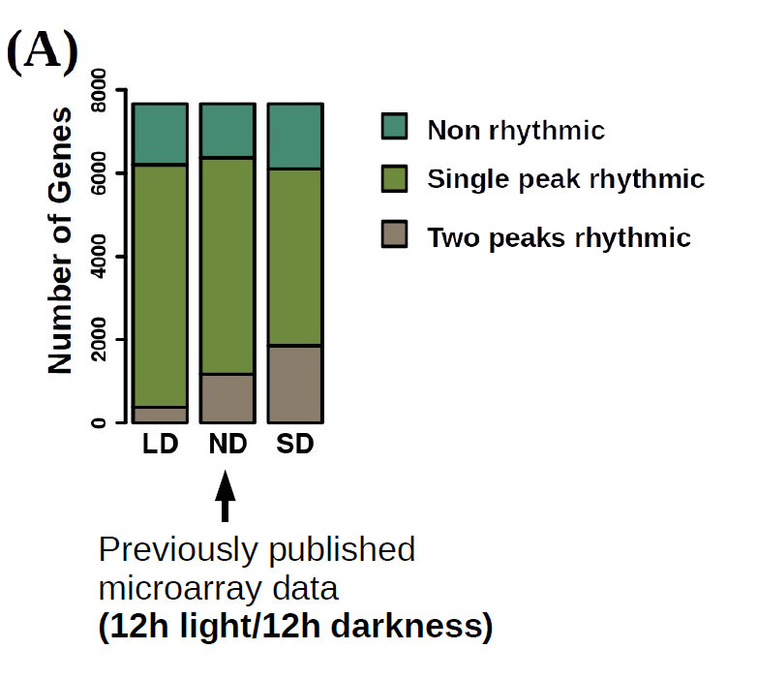
Chapter 2: Transcriptomic analysis
Changes in the transcriptome caused by seasonal cycles
12 h period cycles (2 peaks per day)
Notes:
Here you can see how the number of genes presenting two peaks of expression per day is higher in SD compared to LD.

Slide 177
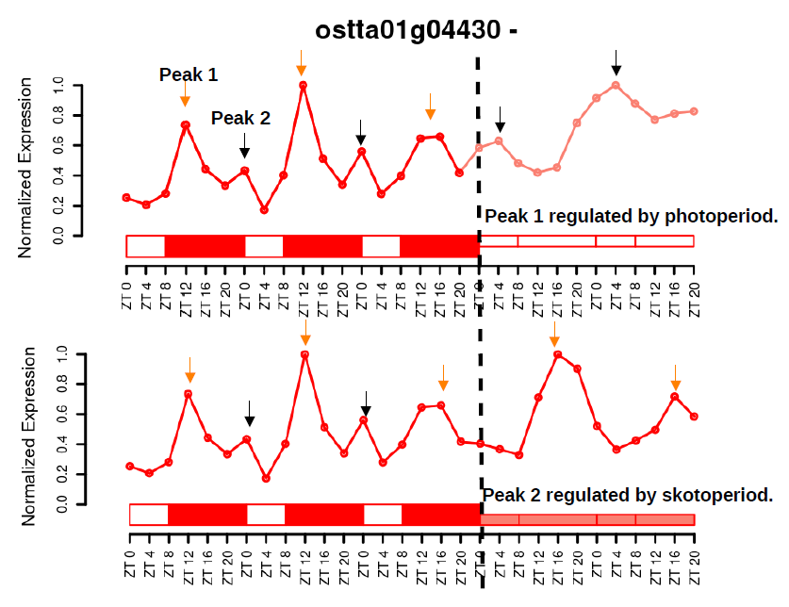
Chapter 2: Transcriptomic analysis
Changes in the transcriptome caused by seasonal cycles
*
*
*
*
*
*
*
Notes:
However, when we take a look at these gene expression profiles with 2 peaks of expression per day

Slide 178
Chapter 2: Transcriptomic analysis
Changes in the transcriptome caused by seasonal cycles
*
*
Bimodality is not maintained under free-running conditions
*
*
*
*
*
Notes:
it can be observed that bimodality is not maintained under free-running conditions

Slide 179
Chapter 2: Transcriptomic analysis
Changes in the transcriptome caused by seasonal cycles
*
*
*
*
*
*
*
*
*
*
*
Notes:
instead one of the peaks is maintained only in constant light

Slide 180
Chapter 2: Transcriptomic analysis
Changes in the transcriptome caused by seasonal cycles
*
*
*
*
*
*
*
*
*
*
*
Notes:
and the second one is only maintained in constant darkness

Slide 181
Chapter 2: Transcriptomic analysis
Changes in the transcriptome caused by seasonal cycles
*
*
*
*
*
*
Peak 1 depending on
photoperiod
*
*
*
*
*
Notes:
This suggests that these two peaks observed under SD condition are a combination of two distinct rhythmic profiles: one depending on the photoperiod

Slide 182
Chapter 2: Transcriptomic analysis
Changes in the transcriptome caused by seasonal cycles
*
*
*
*
*
*
Peak 1 depending on
photoperiod
*
*
*
*
*
Peak 2 depending on
skotoperiod
Notes:
and another depending on the skotoperiod, and this hypothesis was confirmed by applying Fourier analysis.

Slide 183
Chapter 2: Transcriptomic analysis

Slide 184
Chapter 2: Transcriptomic analysis
Changes in the transcriptome caused by seasonal cycles
Predicts the emergence of 12h cycles in gene expression profiles in other seasons
Predictive model entrained with transcriptomic data
Notes:
And once again, with this data a predictive model has been entrained to predice the emergence of secondary peaks in gene expression profiles over the year, which is illustrated in this video.

Slide 185
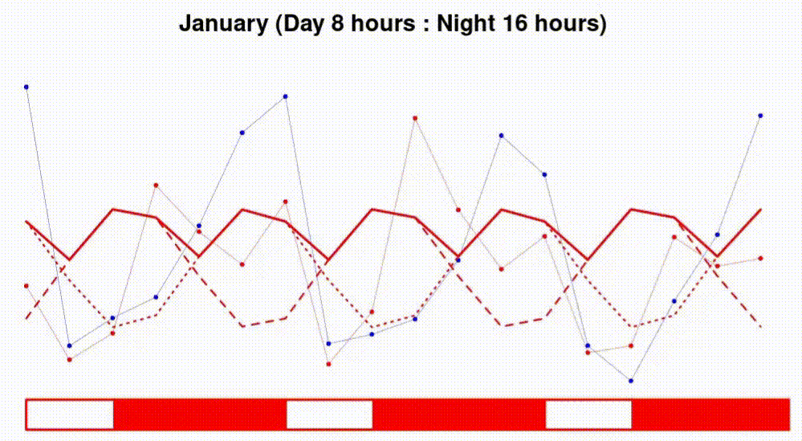
Chapter 2: Transcriptomic analysis
Prediction of the emergence of secondary peaks in gene expression profiles over the year
Notes:
And the simulation or prediction generated is represented here once again using a wider line changing in color. And it shows how the two rhythmic profiles behave differently to changes in photoperiod, with only one of them adapting to those changes. So, they become out of phase as the photoperiod gets shorter resulting in two peaks, and are coincident in LD causing a single peak.

Slide 186

Chapter 2: Transcriptomic analysis
Seasonal cycles induce changes in gene expression profiles consisting in the emergence of 12 h period cycles, phase shifts and amplitude reductions.
Rhythmic profiles with 12 h periods in SD are a combination of two distinct rhythmic profiles being coincident under long photoperiods and becoming out of phase as photoperiod gets shorter
Notes:
So, overall, seasonal cycles induce changes in the transcriptome rhythmicity, such as phase shits, amplitude reductions and the emergence of 12 h period cycles.
These 12h period cycles are a combination of two distinct rhythmic profiles being coincident under long photoperiods and becoming out of phase as photoperiod gets shorter.

Slide 187
Chapter 2: Transcriptomic analysis
Temporal transcriptional programmes.
Characterization of the temporal transcriptional programme over diel cycles in Ostreococcus tauri
Most enriched processes in each time of the day
Notes:
Finally, Focusing on the most enriched biological processes in each time of the day, a characterization of the temporal transcriptional programme of Ostreococcus under each photoperiod is achieved

Slide 188
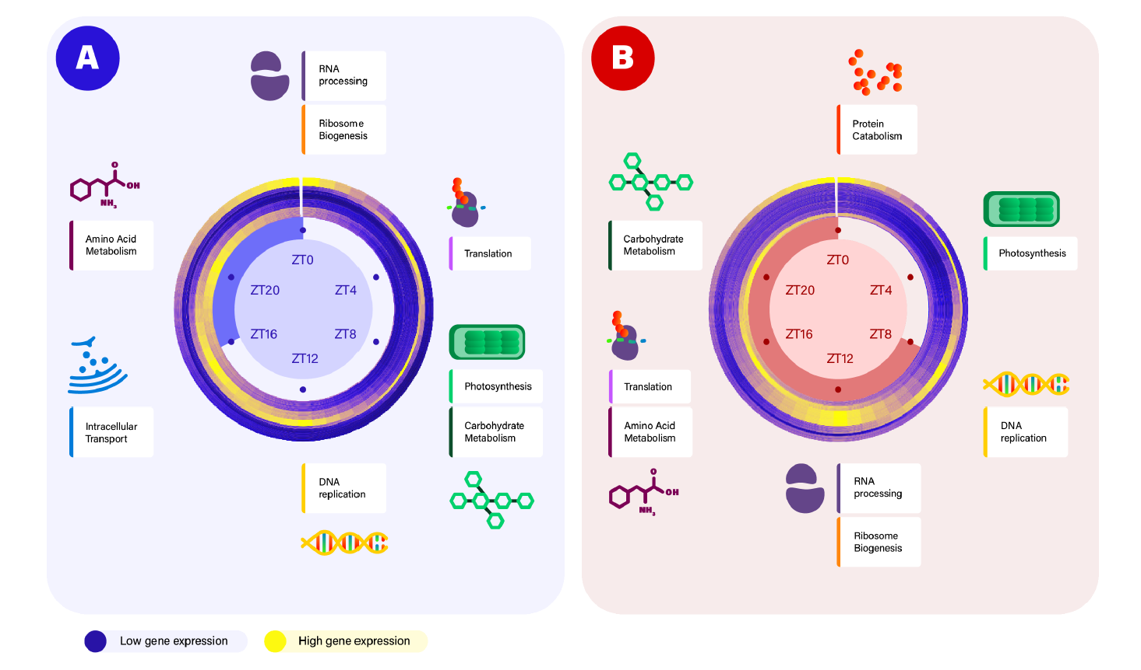
Chapter 2: Transcriptomic analysis
Temporal transcriptional programmes.
Gene
Expression
Low High
LD
SD
Notes:
And this is illustrated in this figure. Here circular heatmaps indicate in yellow color high expression levels of genes peaking at the same time point.

Slide 189
Chapter 2: Transcriptomic analysis
Temporal transcriptional programmes.
Gene
Expression
Low High
LD
SD
Notes:
And these genes are involved in different biological processes.

Slide 190
Chapter 2: Transcriptomic analysis
Temporal transcriptional programmes.
Gene
Expression
Low High
LD
SD
Notes:
And these genes are involved in different biological processes.

Slide 191
Chapter 2: Transcriptomic analysis
Temporal transcriptional programmes.
Gene
Expression
Low High
LD
SD
Notes:
And these genes are involved in different biological processes.

Slide 192
Chapter 2: Transcriptomic analysis
Temporal transcriptional programmes.
Gene
Expression
Low High
LD
SD
Notes:
And these genes are involved in different biological processes.

Slide 193
Chapter 2: Transcriptomic analysis
Temporal transcriptional programmes.
Gene
Expression
Low High
LD
SD
Notes:
And these genes are involved in different biological processes.

Slide 194
Chapter 2: Transcriptomic analysis
Temporal transcriptional programmes.
Gene
Expression
Low High
LD
SD
Notes:
And these genes are involved in different biological processes.

Slide 195
Chapter 2: Transcriptomic analysis
Temporal transcriptional programmes.
Gene
Expression
Low High
LD
SD
Notes:
In general, it can be observed an anticipation of the activation times in SD compared to LD

Slide 196
Chapter 2: Transcriptomic analysis
Temporal transcriptional programmes.
Gene
Expression
Low High
LD
SD
Notes:
, like it happens with photosynthesis

Slide 197

Chapter 2: Transcriptomic analysis
Temporal transcriptional programmes.
Gene
Expression
Low High
LD
SD
Notes:
being activated 4h before in SD photoperiods in order to align with the high irradiance hours, as it does in LD.

Slide 198
Chapter 2: Transcriptomic analysis
Temporal transcriptional programmes.
Gene
Expression
Low High
LD
SD
Notes:
However, there are other processes that are activated in SD 12h

Slide 199
Chapter 2: Transcriptomic analysis
Temporal transcriptional programmes.
Gene
Expression
Low High
LD
SD
Notes:
before they did in LD, like Ribosomes biogenesis and translation.

Slide 200


Chapter 2: Transcriptomic analysis
Temporal transcriptional programmes.
Gene
Expression
Low High
LD
SD
Notes:
As a result of this anticipation, these processes are totally rearranged in a different time of the day in each photoperiod: sunrise in summer and nights in winter

Slide 201

Chapter 2: Transcriptomic analysis
Temporal transcriptional programmes.
Gene
Expression
Low High
LD
SD
Phase shifts globally observed over the transcriptome of Ostreococcus tauri as an adaptation to photoperiods, not only consist in anticipating processes but also in a re-arrangement of the complete diel gene activation programme.
Notes:
This suggests that phase shifts globally observed over the transcriptome of Ostreococcus tauri as an adaptation to photoperiods, not only consist in anticipating processes but also in a re-arrangement of the complete diel gene activation programme.

Slide 202
Chapter 2: Transcriptomic analysis
LD
SD
Transcriptional timing
≠
Physiological timing
Notes:
However, the transcriptional programme observed do not align with the physiological timing of some processes that have been already described in Ostreococcus.

Slide 203
Hypothesis and Objectives
Multiomic characterization of the responses to seasonal variations in diel cycles in Ostreococcus tauri.
To develop software tools, computational pipelines, and models to enhance systems biology studies in microalgae, with a specific focus on exploring the results presented in this thesis.
To characterize transcriptomic seasonal variations during diel cycles and free-running conditions.
To characterize proteomic seasonal variations during diel cycles and their integration with transcriptomic responses.
To characterize seasonal variations in relevant physiological processes during diel cycles and conduct multi-omics integration with transcriptomic and proteomic data.
Notes:
That discordance motivated us to integrate transcriptomics with proteomics. Which takes us to the next objective and chapter where

Slide 204
Chapter 3.
Proteomic analysis of seasonal variations in diel
cycles in Ostreococcus tauri
Notes:
A proteomic analysis of seasonal variations in diel cycles in Ostreococcus tauri is achieved

Slide 205
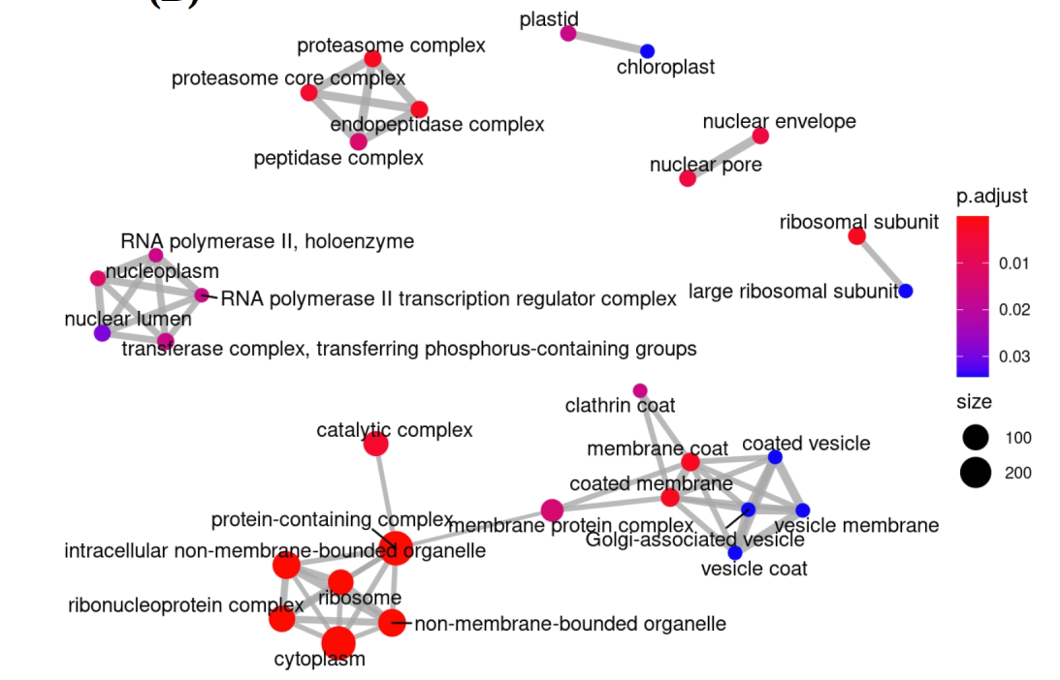
Chapter 3: Proteomic analysis
Covering 45% of the complete proteome
Notes:
This proteomic analysis covers 45% of the proteome of O. tauri and an enrichment analysis over the detected proteins reveals that every cell component is represented in our data.

Slide 206
Chapter 3: Proteomic analysis
Covering 45% of the complete proteome
Nuclear envelope
Nuclear lumen
Notes:
This proteomic analysis covers 45% of the proteome of O. tauri and an enrichment analysis over the detected proteins reveals that every cell component is represented in our data.

Slide 207
Chapter 3: Proteomic analysis
Chloroplast
Covering 45% of the complete proteome
Nuclear envelope
Nuclear lumen
Golgi-associated
Notes:
This proteomic analysis covers 45% of the proteome of O. tauri and an enrichment analysis over the detected proteins reveals that every cell component is represented in our data.

Slide 208
Chapter 3: Proteomic analysis
Proteasome
Chloroplast
Covering 45% of the complete proteome
Nuclear envelope
Nuclear lumen
Cytoplasm
Golgi-associated
Notes:
This proteomic analysis covers 45% of the proteome of O. tauri and an enrichment analysis over the detected proteins reveals that every cell component is represented in our data.

Slide 209
Chapter 3: Proteomic analysis
Proteome rhythmicity.
Non-parametric methods
(RAIN, R package)
Identify significant diel rhythms
=24h in diel cycles
Notes:
Once again non-parametric methods implemented in the R package RAIN are used to identify significant rhythms with 24h periods over the proteome.

Slide 210
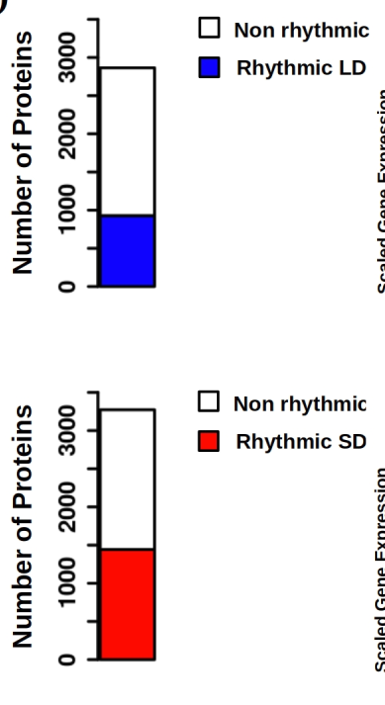
Chapter 3: Proteomic analysis
Proteome rhythmicity.
32% of detected proteome in LD present rhythmic profiles
Notes:
And in LD entrained cultures, 32 % of the proteome detected present rhythmic abundance profiles

Slide 211
Chapter 3: Proteomic analysis
Proteome rhythmicity.
32% of detected proteome in LD present rhythmic profiles
44% of detected proteome in SD present rhythmic profiles
Notes:
and under SD condition the number of rhythmic proteins increase to 44 % of the detected proteome.

Slide 212
Chapter 3: Proteomic analysis
Proteome rhythmicity.
32% of detected proteome in LD present rhythmic profiles
Drastic reduction in rhythmicity over the proteome of Ostreococcus tauri compared with its transcriptome
44% of detected proteome in SD present rhythmic profiles
Notes:
As you can see there is a drastic reduction in rhythmicity over the proteome of Ostreococcus tauri compared with its transcriptome

Slide 213
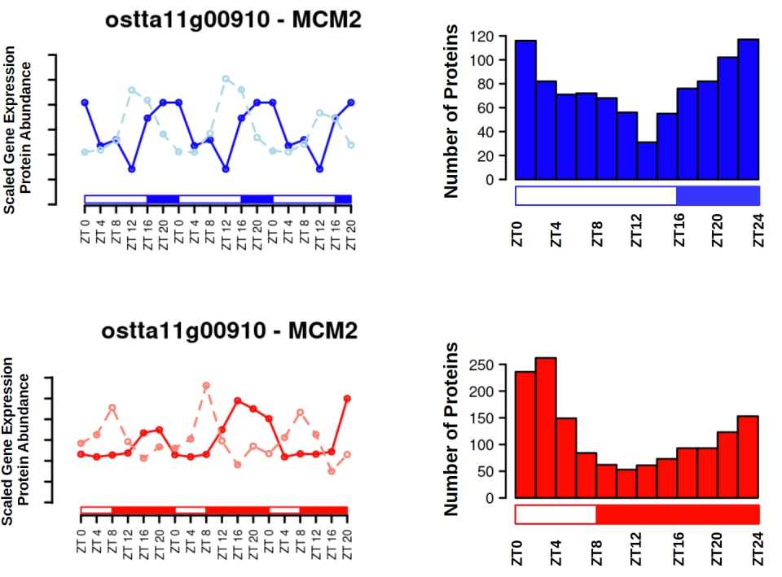
Chapter 3: Proteomic analysis
Proteome rhythmicity.
LD
protein
transcript
SD
protein
transcript
32%
44%
Notes:
In addition, when rhythmic protein abundance profiles (represented here in solid lines) are compared to the corresponding rhythmic gene expression profiles (represented here as dashed lines in LIGHTER color),

Slide 214
Chapter 3: Proteomic analysis
Proteome rhythmicity.
LD
protein
transcript
SD
protein
transcript
32%
44%
Notes:
phase offsets between them are detected. It suggests that translation may take place few hours after gene expression

Slide 215
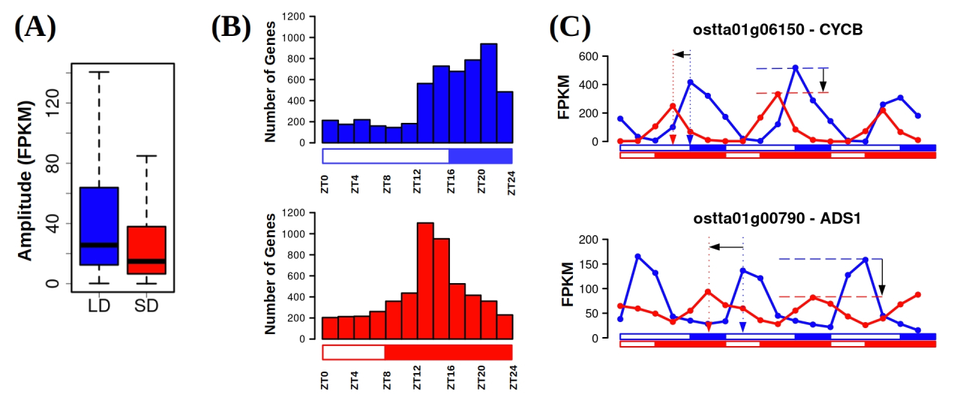
Chapter 3: Proteomic analysis
Proteome rhythmicity.
LD
protein
transcript
SD
protein
transcript
Transcriptome
32%
44%
Notes:
In fact, the majority of the transcripts have their maximum expression level during night hours in both photoperiods, as it can be observed in these histograms where is represented the number of genes having their maximum level of expression at each time of the day

Slide 216
Chapter 3: Proteomic analysis
Proteome rhythmicity.
LD
protein
transcript
SD
protein
transcript
Transcriptome
Proteome
32%
44%
Notes:
With a similar representation but using the proteomic data, it can be observed that the majority of the rhythmic proteins present their maximum abundance level during the light hours.

Slide 217
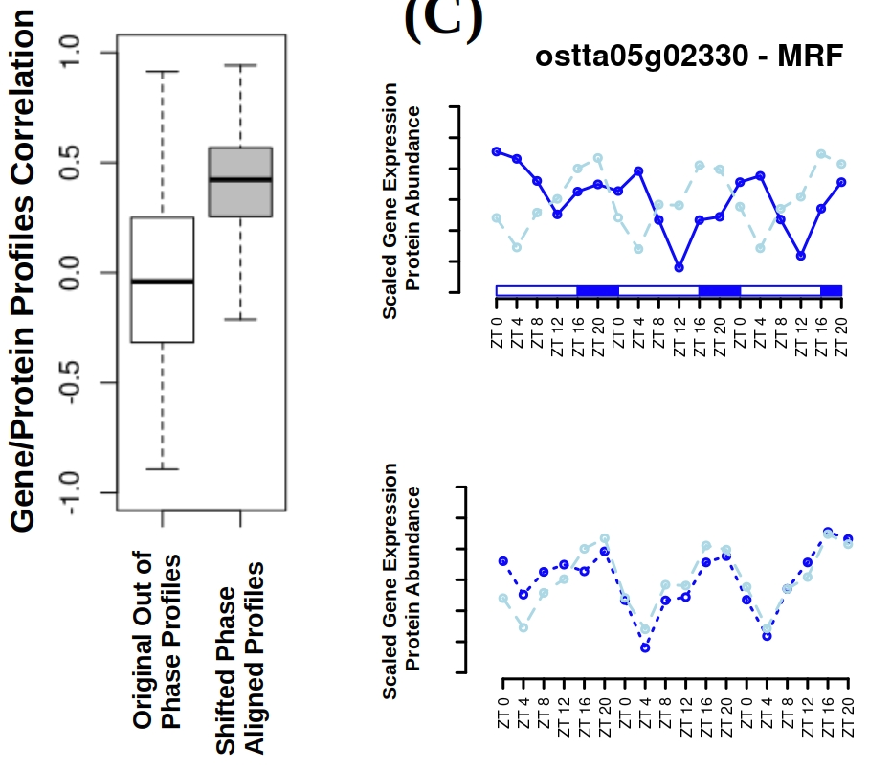
Chapter 3: Proteomic analysis
Notes:
Indeed, a lack of global correlation between proteome and transcriptome dynamics is observed when the original profiles with pase offsets are compared.

Slide 218
Chapter 3: Proteomic analysis
Notes:
However, when these two abundance profiles are aligned omitting transcript-protein offsets

Slide 219
Chapter 3: Proteomic analysis
Notes:
a positive higher average correlation is found.

Slide 220
Chapter 3: Proteomic analysis
This high correlation between aligned protein and transcript abundance profiles indicates that transcriptome and proteome dynamics are indeed linked but separated temporally
Notes:
This high correlation indicates that transcriptome and proteome dynamics are indeed liked but separated temporally.

Slide 221
Chapter 3: Proteomic analysis
Temporal offset correlation with protein properties, photoperiod and biological function.
Extensive analysis of the correlation between transcript-protein offset with different protein properties (hydrophobicity, isoelectric point, length, charge, etc.):
Notes:
In order to obtain a deeper understanding of transcript-protein phase offsets

Slide 222
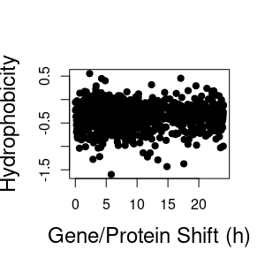
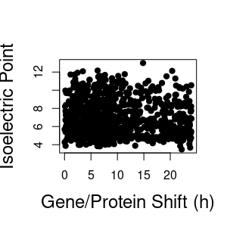
Chapter 3: Proteomic analysis
Temporal offset correlation with protein properties, photoperiod and biological function.
Extensive analysis of the correlation between transcript-protein offset with different protein properties (hydrophobicity, isoelectric point, length, charge, etc.):
Notes:
an extensive analysis of its correlation with different protein properties, like hydrophobicity and isoelectric point among others is carried out.

Slide 223
Chapter 3: Proteomic analysis
Temporal offset correlation with protein properties, photoperiod and biological function.
Extensive analysis of the correlation between transcript-protein offset with different protein properties (hydrophobicity, isoelectric point, length, charge, etc.):
No correlation between transcripts-protein offsets and any protein properties given by its sequence of aminoacids
Notes:
And the results shows no positive or negative correlation between offsets and any protein properties given by its sequence of aminoacids

Slide 224
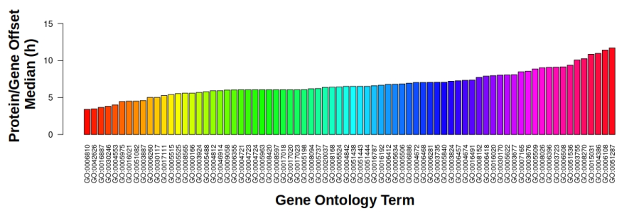
Chapter 3: Proteomic analysis
Temporal offset correlation with protein properties, photoperiod and biological function.
Notes:
Instead, the transcript-protein offset IS dependant on the specific biological processes in which the corresponding proteins are involved according to Gene Ontology annotation.

Slide 225
Chapter 3: Proteomic analysis
Temporal offset correlation with protein properties, photoperiod and biological function.
Notes:
Also there is a seasonal effect over this offset, presenting longer transcript-protein offsets during winter short day photoperiod, as it can be observed in this boxplot.

Slide 226
Chapter 3: Proteomic analysis
Temporal offset correlation with protein properties, photoperiod and biological function.
Proteins involved in the same biological process present similar transcript-protein offsets, that differ between processes and are increased under winter short photoperiod.
Notes:
That means, that proteins involved in the same biological process present similar transcript-protein offset, that differ between processes and are increased under winter short photoperiod

Slide 227
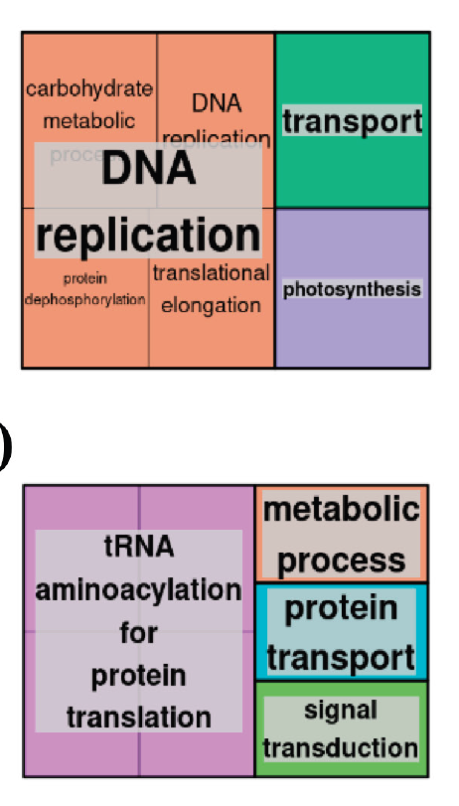
Chapter 3: Proteomic analysis
Temporal offset correlation with protein properties, photoperiod and biological function.
Short transcript-protein offset
Notes:
Specifically, the biological processes with short offsets are DNA replication and photosynthesis.

Slide 228
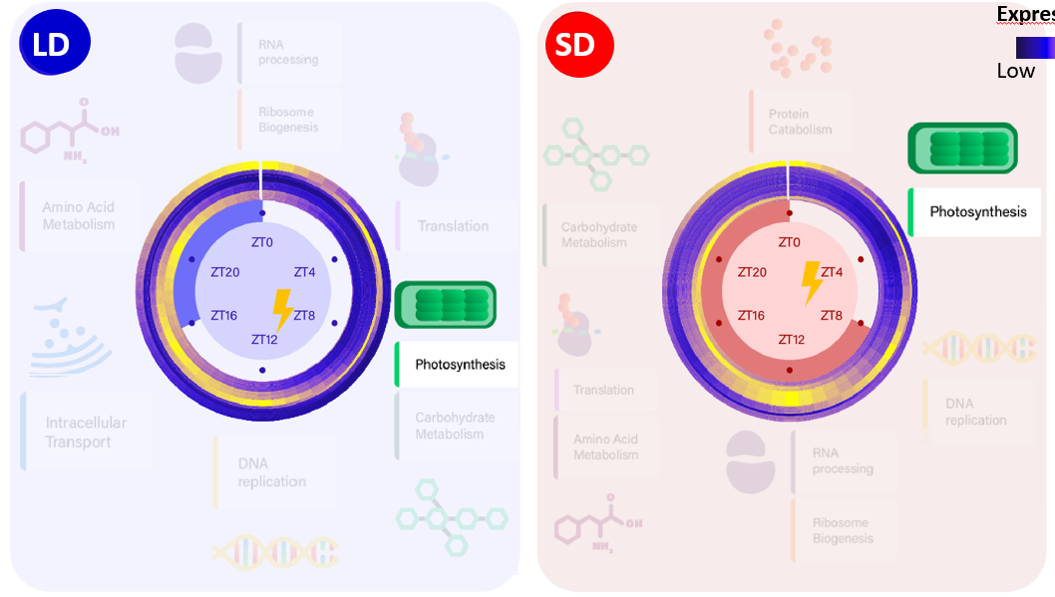
Chapter 3: Proteomic analysis
Temporal offset correlation with protein properties, photoperiod and biological function.
Notes:
In the transcriptional program we observed that genes involved in photosynthesis presented a short anticipation in time between seasons in order to align with the high irradiance hours

Slide 229
Chapter 3: Proteomic analysis
Temporal offset correlation with protein properties, photoperiod and biological function.
Short transcript-protein offset
Notes:
Now, the proteomic analysis suggests that the activation of this set of genes is strategically placed at that time of the day taking in consideration their short transcript-protein offset, so no further anticipation to the high irradiance hours is needed.

Slide 230
Chapter 3: Proteomic analysis
Temporal offset correlation with protein properties, photoperiod and biological function.
Short transcript-protein offset
Long transcript-protein offset
Notes:
Whereas, processes involved in translation are the most representative ones exhibiting long transcript-protein offsets.

Slide 231
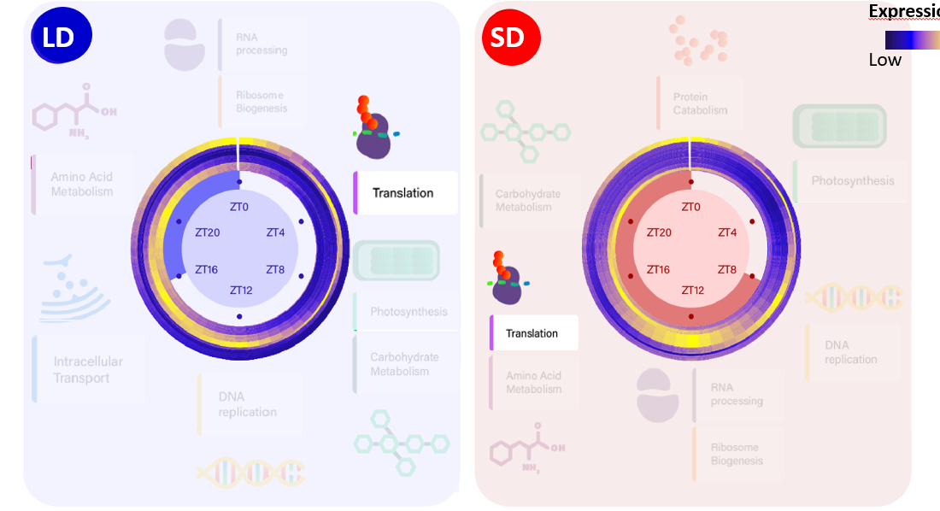
Chapter 3: Proteomic analysis
Temporal offset correlation with protein properties, photoperiod and biological function.
Notes:
Which in the transcriptional temporal program presented 12h of anticipation between seasons.

Slide 232
Chapter 3: Proteomic analysis
Temporal offset correlation with protein properties, photoperiod and biological function.
Long transcript-protein offset
Notes:
This different behavior could be associated to the long transcript-protein offset that this processes actually presents, that even becomes longer in Winter photoperiod.

Slide 233
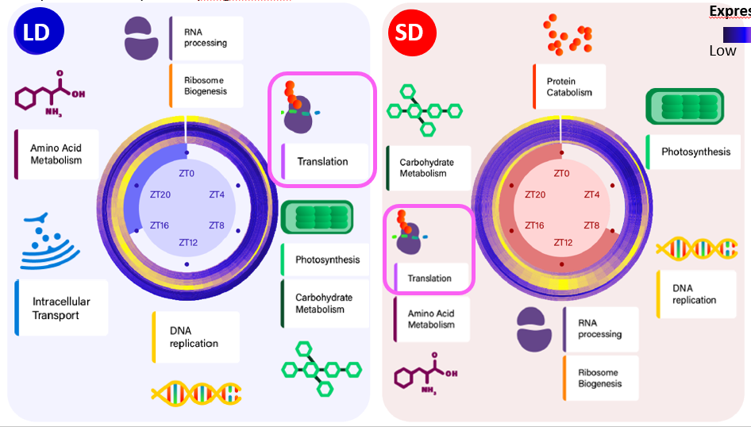
Chapter 3: Proteomic analysis
Temporal offset correlation with protein properties, photoperiod and biological function.
Ostreococcus tauri severely reorganize its transcriptional temporal programme considering not only the current photoperiod but also the different transcript-proteins offsets that each biological process presents.
Long transcript-protein offset

Slide 234
Hypothesis and Objectives
Multiomic characterization of the responses to seasonal variations in diel cycles in Ostreococcus tauri.
To develop software tools, computational pipelines, and models to enhance systems biology studies in microalgae, with a specific focus on exploring the results presented in this thesis.
To characterize transcriptomic seasonal variations during diel cycles and free-running conditions.
To characterize proteomic seasonal variations during diel cycles and their integration with transcriptomic responses.
To characterize seasonal variations in some relevant physiological processes during diel cycles and conduct multi-omics integration with transcriptomic and proteomic data.
Notes:
Now that multiomic data have been analysed,

Slide 235
Hypothesis and Objectives
Multiomic characterization of the responses to seasonal variations in diel cycles in Ostreococcus tauri.
To develop software tools, computational pipelines, and models to enhance systems biology studies in microalgae, with a specific focus on exploring the results presented in this thesis.
To characterize transcriptomic seasonal variations during diel cycles and free-running conditions.
To characterize proteomic seasonal variations during diel cycles and their integration with transcriptomic responses.
To characterize seasonal variations in some relevant physiological processes during diel cycles and conduct multi-omics integration with transcriptomic and proteomic data.
Multi-omic integration
Biological Validation
Notes:
it is imperative to integrate the results with physiological data in order to understand how molecular dynamics regulate physiological processes as a response to seasonal variations in diel cycles. This chapter not only serves as a biological validation of the results, but also as a crucial component to understand rhythmic systems.

Slide 236
Hypothesis and Objectives
Multiomic characterization of the responses to seasonal variations in diel cycles in Ostreococcus tauri.
To develop software tools, computational pipelines, and models to enhance systems biology studies in microalgae, with a specific focus on exploring the results presented in this thesis.
To characterize transcriptomic seasonal variations during diel cycles and free-running conditions.
To characterize proteomic seasonal variations during diel cycles and their integration with transcriptomic responses.
To characterize seasonal variations in some relevant physiological processes during diel cycles and conduct multi-omics integration with transcriptomic and proteomic data.
Multi-omic integration
Biological Validation
Notes:
This chapter not only serves as a biological validation of the results, but also as a crucial component to understand rhythmic systems.

Slide 237
Chapter 4.
Diel and seasonal multi-omic integration with physiological data
Notes:
That is approached in the last chapter

Slide 238
Chapter 4: Multi-omic integration with physiological data
Physiological processes presenting robust rhythmic molecular dynamics and different transcript-protein offsets are studied now in detail:
Cell division cycle
Photosynthesis and starch metabolism
Carotenoid biosynthesis
Nitrate assimilation
Notes:
where physiological processes that present robust rhythmic molecular dynamics and different transcript-proteins offsets are studied in detail

Slide 239
Chapter 4: Multi-omic integration with physiological data
Physiological processes presenting robust rhythmic molecular dynamics and different transcript-protein offsets are studied now in detail:
Cell division cycle
Photosynthesis and starch metabolism
Carotenoid biosynthesis
Nitrate assimilation
Notes:
And, starting with the cell division cycle

Slide 240
Chapter 4: Multi-omic integration with physiological data
Characterization of Ostreococcus temporal progression of the cell division under different photoperiods in our culture systems
Summer long day
(16h light / 8h dark)
Samples taken every 4h
Winter short day
(8h light / 16h dark)
ZT = Zetigeber Time
Notes:
In this chapter, the samples taken every 4h during

Slide 241
Chapter 4: Multi-omic integration with physiological data
Characterization of Ostreococcus temporal progression of the cell division under different photoperiods in our culture systems
Summer long day
(16h light / 8h dark)
Samples taken every 4h
Winter short day
(8h light / 16h dark)
ZT = Zetigeber Time
Notes:
3 consecutive days under LD and SD photoperiods

Slide 242
Chapter 4: Multi-omic integration with physiological data
Characterization of Ostreococcus temporal progression of the cell division under different photoperiods in our culture systems
Summer long day
(16h light / 8h dark)
Samples taken every 4h
Winter short day
(8h light / 16h dark)
ZT = Zeitgeber Time
Notes:
during 3 consecutive days under LD and SD photoperiods

Slide 243
Chapter 4: Multi-omic integration with physiological data
Characterization of Ostreococcus temporal progression of the cell division under different photoperiods in our culture systems
Summer long day
(16h light / 8h dark)
Samples taken every 4h
DNA content estimation using Flow cytometry
Winter short day
(8h light / 16h dark)
ZT = Zeitgeber Time
Notes:
were used in flow cytometry to estimate DNA content in cell population at different times of the day.

Slide 244
Chapter 4: Multi-omic integration with physiological data
Characterization of Ostreococcus temporal progression of the cell division cycle under different photoperiods in our culture systems
Summer long day
(16h light / 8h dark)
Samples taken every 4h
DNA content estimation using Flow cytometry
% of Cells in each phase of the cell division cycle
Winter short day
(8h light / 16h dark)
ZT = Zeitgeber Time
Notes:
Based on the estimation of DNA content, the mean percentage of cells involved in each phase of the cell division cycle at different times of the day WERE calculated, allowing the characterization of the temporal progression of the cell division cycle in Ostreococcus under different photoperiods in our culture systems. Which will be now presented.

Slide 245
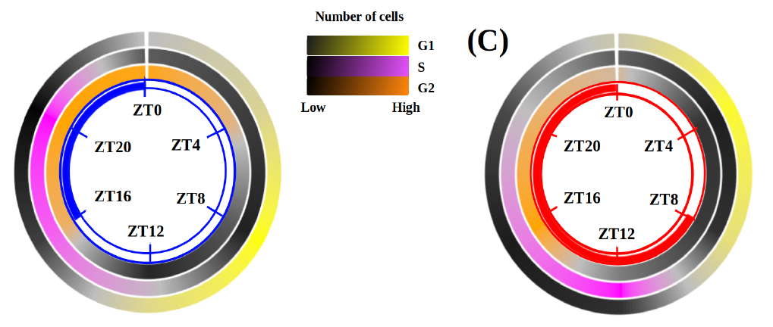
Chapter 4: Multi-omic integration with physiological data
Characterization of Ostreococcus temporal progression of the cell division cycle under different photoperiods in our culture systems
LD
SD
|M
|M
|M
Notes:
The first phase of the cell division cycle, called G1 phase, is where cell growth takes place

Slide 246
Chapter 4: Multi-omic integration with physiological data
Characterization of Ostreococcus temporal progression of the cell division cycle under different photoperiods in our culture systems
LD
SD
|M
|M
Notes:
predominantly occurs during the light hours, with the maximum percentage of cells in this phase, represented in yellow

Slide 247

Chapter 4: Multi-omic integration with physiological data
Characterization of Ostreococcus temporal progression of the cell division cycle under different photoperiods in our culture systems
LD
SD
|M
|M
Notes:
with the maximum percentage of cells in this phase, represented in yellow, coinciding with the maximum irradiance hours.

Slide 248
Chapter 4: Multi-omic integration with physiological data
Characterization of Ostreococcus temporal progression of the cell division cycle under different photoperiods in our culture systems
LD
SD
|M
|M
|M
Notes:
Then, the number of cells in G1 gradually decreases as cells enter in the following phase of the cell cycle, the S phase, where DNA replication takes place

Slide 249

Chapter 4: Multi-omic integration with physiological data
Characterization of Ostreococcus temporal progression of the cell division cycle under different photoperiods in our culture systems
LD
SD
|M
|M
Notes:
The highest number of cells in the S phase, here represented in pink is reached SHORTLY AFTER sunset under both photoperiods.

Slide 250
Chapter 4: Multi-omic integration with physiological data
Characterization of Ostreococcus temporal progression of the cell division cycle under different photoperiods in our culture systems
LD
SD
|M
Notes:
Subsequently, as DNA REPLICATION is successfully accomplished, the number of cells in the next phase of the cell cycle is increased. This phase is called G2|M and is the phase where division takes place, represented in orange in these heatmaps.

Slide 251
Chapter 4: Multi-omic integration with physiological data
Characterization of Ostreococcus temporal progression of the cell division cycle under different photoperiods in our culture systems
LD
SD
|M
|M
Notes:
The transition from this phase to the beginning of the cycle again, the G1 phase, marks the moment when cell divisionis completed.

Slide 252

Chapter 4: Multi-omic integration with physiological data
Characterization of Ostreococcus temporal progression of the cell division cycle under different photoperiods in our culture systems
LD
SD
*
Cell division completed
|M
|M
Notes:
This event takes place during the first part of the morning IN LD. This indicates that cell division in Ostreococcus takes place during the nights and during the morning in summer long photoperiods.

Slide 253

Chapter 4: Multi-omic integration with physiological data
Characterization of Ostreococcus temporal progression of the cell division cycle under different photoperiods in our culture systems
Cell division completed
*
LD
SD
*
Cell division completed
|M
|M
Notes:
However, cell division exclusively occurs by night in SD. As soon as the sun rises, cell division is completed, allowing cells to undergo growth in the morning maximizing the utilization of available daylight hours.

Slide 254
Chapter 4: Multi-omic integration with physiological data
Anticipation of chloroplast division
Notes:
This anticipation is also observed in chloroplast division.

Slide 255
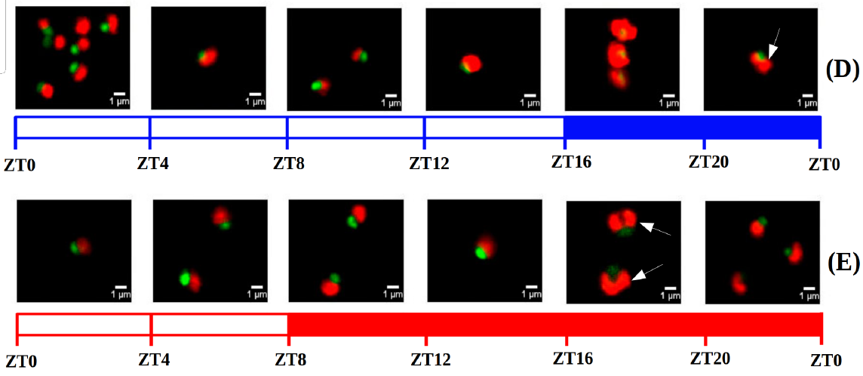
Chapter 4: Multi-omic integration with physiological data
Anticipation of chloroplast division
Confocal microscopy image of O. tauri with dyed nucleus
Notes:
Here you can see confocal microscopy pictures where a green fluorescent was used to dye DNA in the nucleus and natural fluorescence of chloroplasts is showing in red.

Slide 256
Chapter 4: Multi-omic integration with physiological data
Anticipation of chloroplast division
Confocal microscopy image of O. tauri with dyed nucleus
Notes:
And in that way it was observed how a significant number of cells still presented 2 chloroplasts by the end of the night.

Slide 257
Chapter 4: Multi-omic integration with physiological data
Anticipation of chloroplast division
Confocal microscopy image of O. tauri with dyed nucleus
Notes:
While in SD they are found around midnight

Slide 258
Chapter 4: Multi-omic integration with physiological data
Anticipation of chloroplast division
Confocal microscopy image of O. tauri with dyed nucleus
Notes:
and by the end of the night , a substantial number of cells already possess only one chloroplast during the short photoperiod

Slide 259
Chapter 4: Multi-omic integration with physiological data
Anticipation of chloroplast division
Cell division cycle is strongly influenced by the circadian clock and can anticipate cyclic changes, such as the reduced light period during winter photoperiods.
Notes:
These findings suggest that the cell division cycle is strongly influenced by the circadian clock and can anticipate cyclic changes, such as the reduced light period during winter photoperiods.

Slide 260
Chapter 4: Multi-omic integration with physiological data
Characterization of Ostreococcus temporal progression of the cell division cycle under different photoperiods in our culture systems
Cell division completed
*
LD
SD
*
Cell division completed
|M
|M
Notes:
Now, I’m going to

Slide 261
Chapter 4: Multi-omic integration with physiological data
Characterization of Ostreococcus temporal progression of the cell division cycle under different photoperiods in our culture systems
Cell division completed
*
LD
SD
*
Cell division completed
|M
|M
Notes:
to focus on the S phase, as an example to show how these results were integrated with the generated omic data.

Slide 262
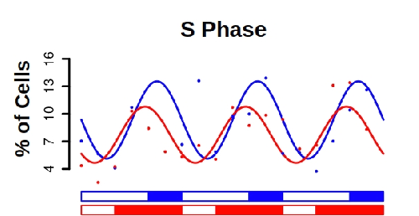
Chapter 4: Multi-omic integration with physiological data
Notes:
The wave described by the change in the % of cells in the S phase during the 3 consecutive days of sampling.

Slide 263
Chapter 4: Multi-omic integration with physiological data
Notes:
The wave described by the change in the % of cells in the S phase the 3 consecutive days of sampling.

Slide 264
Chapter 4: Multi-omic integration with physiological data
Notes:
The wave described by the change in the % of cells in the S phase the 3 consecutive days of sampling.

Slide 265
Chapter 4: Multi-omic integration with physiological data
Rhythmic profile (24h period)
with p-value < 0.05
Notes:
corresponds to a rhythmic diel profile under both photoperiods

Slide 266
Chapter 4: Multi-omic integration with physiological data
Rhythmic profile (24h period)
with p-value < 0.05
Notes:
and amplitude reductions

Slide 267
Chapter 4: Multi-omic integration with physiological data
Rhythmic profile (24h period)
with p-value < 0.05
Amplitude reductions and phase shifts aligning with seasonal effects observed over rhythmic molecular dynamics
Notes:
and phase shifts are also reflected in the actual biological rhythm aligning with the seasonal effects over rhythmic molecular dynamics

Slide 268
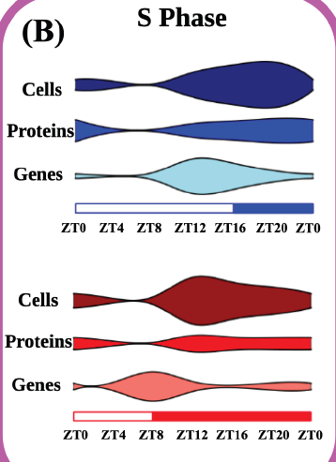
Chapter 4: Multi-omic integration with physiological data
S Phase
Notes:
Now the mean percentage of cells in the S phase during the day is represented in violin plots, where the wider the violin get, the higher the percentage of cells is in that time point

Slide 269
Chapter 4: Multi-omic integration with physiological data
S Phase
Notes:
And I do the same with the proteins abundance levels

Slide 270
Chapter 4: Multi-omic integration with physiological data
S Phase
Notes:
and transcripts involved in DNA replication. Here it ca be observed how the dynamics observed in the transcriptomic data are reflected also in the proteomic data and the percentage of cells,

Slide 271
Chapter 4: Multi-omic integration with physiological data
S Phase
Notes:
Except for the temporal offset existing between transcripts and proteins, that are aLMOST NON-EXISTING IN LD AND BECOMES EVIDENT IN SD.

Slide 272
Chapter 4: Multi-omic integration with physiological data
S Phase
Notes:
Except for the temporal offset existing between transcripts and proteins, that are aLMOST NON-EXISTING IN LD AND BECOMES EVIDENT IN SD.

Slide 273
Chapter 4: Multi-omic integration with physiological data
S Phase
Gene expression profiles did not maintain their rhythmicity in DD after LD and SD entrainment
Notes:
Also, in chapter 2 we have seen how genes involved in DNA replication did not maintain their rhythmic expression profiles under DD presenting light-dependance.

Slide 274
Chapter 4: Multi-omic integration with physiological data
S Phase
The cell division cycle, possesses a complex regulatory mechanism comprising light-dependence and robust circadian clock transcriptional regulation that allow Ostreococcus to anticipate cyclic changes like the short day in winter photoperiods.
Gene expression profiles did not maintain their rhythmicity in DD after LD and SD entrainment
Notes:
That the cell division cycle, possesses a complex regulatory mechanism comprising light-dependence and robust circadian clock transcriptional regulation that allow Ostreococcus to anticipate cyclic changes like the short day in winter photoperiods.

Slide 275
Chapter 4: Multi-omic integration with physiological data
Physiological processes presenting robust rhythmic molecular dynamics and different transcript-protein offsets are studied now in detail:
Cell division cycle
Photosynthesis and starch metabolism
Carotenoid biosynthesis
Nitrate assimilation
Notes:
The following process studied in detail was photosynthesis and starch metabolism

Slide 276
Chapter 4: Multi-omic integration with physiological data
Samples taken every 4h
Summer long day
(16h light / 8h dark)
Winter short day
(8h light / 16h dark)
ZT = Zeitgeber Time
Notes:
In order to do that samples were once again taken every 4h

Slide 277
Chapter 4: Multi-omic integration with physiological data
Samples taken every 4h
Pulse amplitude modulation (PAM) to estimate maximum quantum efficiency (Fv/Fm)
Summer long day
(16h light / 8h dark)
Winter short day
(8h light / 16h dark)
ZT = Zeitgeber Time
Notes:
and pals amplitude modulation was used to estimate the maximum quantum efficiency (Fv/Fm)

Slide 278
Chapter 4: Multi-omic integration with physiological data
Samples taken every 4h
Pulse amplitude modulation (PAM) to estimate maximum quantum efficiency (Fv/Fm)
Summer long day
(16h light / 8h dark)
Winter short day
(8h light / 16h dark)
ZT = Zeitgeber Time
Notes:
at different times of the day.

Slide 279

Chapter 4: Multi-omic integration with physiological data
Fv/Fm
Integrity and efficiency of Photosystem II (PSII)
PSII
Notes:
This metric is used to estimate the integrity and efficiency of Photosystem II (PSII)

Slide 280
Chapter 4: Multi-omic integration with physiological data
Fv/Fm
Integrity and efficiency of Photosystem II (PSII)
Photosynthetic efficiency
PSII
Notes:
so is commonly related to photosynthetic efficiency

Slide 281
Chapter 4: Multi-omic integration with physiological data
Characterization of changes in photosynthetic efficiency during diel cycles
Rhythmic profile
(24h period)
with p-value < 0.05
PSII
Notes:
In LD entrained cultures, photosynthetic efficiency presents a rhythmic profile with a 24 h period.

Slide 282
Chapter 4: Multi-omic integration with physiological data
Characterization of changes in photosynthetic efficiency during diel cycles
Rhythmic profile
(24h period)
with p-value < 0.05
ZT8
ZT8
ZT8
PSII
Notes:
Presenting only one peak per day coinciding with the high irradiance hours

Slide 283
Chapter 4: Multi-omic integration with physiological data
Characterization of changes in photosynthetic efficiency during diel cycles
Rhythmic profile
(24h period)
with p-value < 0.05
ZT8
ZT8
ZT8
Rhythmic profile
(12h period)
with p-value < 0.05
PSII
Notes:
However, in SD entrained cultures phosynthetic efficiency present a rhythmic profile with 12h period, presenting two peaks per day

Slide 284
Chapter 4: Multi-omic integration with physiological data
Characterization of changes in photosynthetic efficiency during diel cycles
Rhythmic profile
(24h period)
with p-value < 0.05
ZT8
ZT8
ZT8
Rhythmic profile
(12h period)
with p-value < 0.05
PSII
ZT8
ZT8
ZT8
Notes:
one of them coinciding with the peak observed in LD

Slide 285
Chapter 4: Multi-omic integration with physiological data
Characterization of changes in photosynthetic efficiency during diel cycles
Rhythmic profile
(24h period)
with p-value < 0.05
ZT8
ZT8
ZT8
Rhythmic profile
(12h period)
with p-value < 0.05
PSII
ZT8
ZT20
ZT8
ZT20
ZT8
ZT20
Notes:
And the other appears as a smaller increment during the last hours of the night.

Slide 286
Chapter 4: Multi-omic integration with physiological data
Characterization of changes in photosynthetic efficiency during diel cycles
Rhythmic profile
(24h period)
with p-value < 0.05
ZT8
ZT8
ZT8
Rhythmic profile
(12h period)
with p-value < 0.05
Aligning with transcriptome 12h rhythms in SD
PSII
ZT8
ZT20
ZT8
ZT20
ZT8
ZT20
Notes:
These rhythms are a biological validation of the 12h period rhythms observed SD transcriptomes.

Slide 287

Chapter 4: Multi-omic integration with physiological data
Integration of changes in photosynthetic efficiency during diel cycles with multi-omics data
Fv/Fm
PSII proteins
PSII genes
ZT8
ZT8
ZT8
Fv/Fm
PSII genes
ZT8
ZT20
ZT8
ZT20
ZT8
ZT20
Notes:
Now using once again violin plots, the photosynthetic efficiency rhythms are integrated with

Slide 288
Chapter 4: Multi-omic integration with physiological data
Characterization of changes in photosynthetic efficiency during diel cycles
Fv/Fm
PSII proteins
PSII genes
ZT8
ZT8
ZT8
Fv/Fm
PSII proteins
PSII genes
ZT8
ZT20
ZT8
ZT20
ZT8
ZT20
Notes:
abundance levels of proteins and transcripts constituting the photosystem two.

Slide 289
Chapter 4: Multi-omic integration with physiological data
Integration of changes in photosynthetic efficiency during diel cycles with multi-omics data
Fv/Fm
PSII proteins
PSII genes
ZT8
ZT8
ZT8
Fv/Fm
PSII proteins
PSII genes
ZT8
ZT20
ZT8
ZT20
ZT8
ZT20
Notes:
Photosynthesis is one of the processes presenting short transcripts-proteins offsets, so in LD entrained cultures almost no temporal offsets are observed between gene expression, translation and high photosynthetic efficiency values

Slide 290
Chapter 4: Multi-omic integration with physiological data
Integration of changes in photosynthetic efficiency during diel cycles with multi-omics data
Fv/Fm
PSII proteins
PSII genes
ZT8
ZT8
ZT8
Fv/Fm
PSII proteins
PSII genes
ZT8
ZT20
ZT8
ZT20
ZT8
ZT20
Notes:
However, this offset between gene expression and translation becomes evident in short day, as it has been discussed in Chapter 3.

Slide 291
Chapter 4: Multi-omic integration with physiological data
Characterization of changes in photosynthetic efficiency during diel cycles
Fv/Fm
PSII proteins
Rhythmic molecular dynamics align with photosynthetic efficiency changes and secondary peaks observed in SD expression profiles of genes encoding the photosynthetic machinery possibly serve as an anticipation to short day in winter photoperiod.
PSII genes
ZT8
ZT8
ZT8
Fv/Fm
PSII proteins
PSII genes
ZT8
ZT20
ZT8
ZT20
ZT8
ZT20
Notes:
This observations suggest that The secondary peak observed in SD expression profiles of genes encoding the photosynthetic machinery possibly serve as an anticipation to short day in winter photoperiod.

Slide 292
Chapter 4: Multi-omic integration with physiological data
Integration of changes in photosynthetic efficiency during diel cycles with multi-omics data
Notes:
And besides PSII, there are other complex are also crucial in photosynthesis.

Slide 293
Chapter 4: Multi-omic integration with physiological data
Integration of changes in photosynthetic efficiency during diel cycles with multi-omics data
Notes:
As Cytocromo b6f

Slide 294
Chapter 4: Multi-omic integration with physiological data
Integration of changes in photosynthetic efficiency during diel cycles with multi-omics data
Notes:
Photosystem I and Ferredoxin NADP reductase complex

Slide 295
Chapter 4: Multi-omic integration with physiological data
Integration of changes in photosynthetic efficiency during diel cycles with multi-omics data
synthase
Notes:
And ATP synthase

Slide 296

Chapter 4: Multi-omic integration with physiological data
Integration of changes in photosynthetic efficiency during diel cycles with multi-omics data
Transcripts
Cyt b6f
PetC
PetE
synthase
PetF
Notes:
the expression profiles of the genes encoding these proteins are now illustrated in heatmaps

Slide 297
Chapter 4: Multi-omic integration with physiological data
Integration of changes in photosynthetic efficiency during diel cycles with multi-omics data
Transcripts
Cyt b6f
PetC
PetE
synthase
PetF
PsaD
PsaE
PSI
PsaG
PsaL
PsaH
PsaN
PsaF
FNR
Fd
FNR
Notes:
the expression profiles of the genes encoding these proteins are now illustrated in heatmaps

Slide 298
Chapter 4: Multi-omic integration with physiological data
Integration of changes in photosynthetic efficiency during diel cycles with multi-omics data
Transcripts
Cyt b6f
PetC
PetE
synthase
PetF
PsaD
PsaE
PSI
PsaG
PsaL
PsaH
PsaN
PsaF
FNR
Fd
FNR
ATPC
ATPase
ATPD
ATPG
Notes:
the expression profiles of the genes encoding these proteins are now illustrated in heatmaps

Slide 299
Chapter 4: Multi-omic integration with physiological data
Integration of changes in photosynthetic efficiency during diel cycles with multi-omics data
Transcripts
Gene expression
Low High
Cyt b6f
PetC
PetE
synthase
PetF
PsaD
PsaE
PSI
PsaG
PsaL
PsaH
PsaN
PsaF
FNR
Fd
FNR
ATPC
ATPase
ATPD
ATPG
Notes:
where high gene expression is represented in yellow.

Slide 300
Chapter 4: Multi-omic integration with physiological data
Integration of changes in photosynthetic efficiency during diel cycles with multi-omics data
Transcripts
Gene expression
Low High
Cyt b6f
PetC
PetE
synthase
PetF
PsaD
PsaE
PSI
PsaG
PsaL
PsaH
PsaN
PsaF
FNR
Fd
FNR
ATPC
ATPase
ATPD
ATPG
Notes:
All these genes, present high gene expression levels during the morning in LD

Slide 301
Chapter 4: Multi-omic integration with physiological data
Integration of changes in photosynthetic efficiency during diel cycles with multi-omics data
Transcripts
Gene expression
Low High
Cyt b6f
PetC
PetE
synthase
PetF
PsaD
PsaE
PSI
PsaG
PsaL
PsaH
PsaN
PsaF
FNR
Fd
FNR
ATPC
ATPase
ATPD
ATPG
Notes:
coinciding with one of the expression peaks that they present in SD.

Slide 302
Chapter 4: Multi-omic integration with physiological data
Integration of changes in photosynthetic efficiency during diel cycles with multi-omics data
Transcripts
Gene expression
Low High
Cyt b6f
PetC
PetE
synthase
PetF
PsaD
PsaE
PSI
PsaG
PsaL
PsaH
PsaN
PsaF
FNR
Fd
FNR
ATPC
ATPase
ATPD
ATPG
Notes:
These genes also present two peaks of expression per day, and the second peak appears during the last hours of the night, as it was also observed in the PSII.

Slide 303
Chapter 4: Multi-omic integration with physiological data
Integration of changes in photosynthetic efficiency during diel cycles with multi-omics data
Similar molecular dynamics are also found in Calvin cycle and starch metabolism
Transcripts
Gene expression
Low High
Cyt b6f
PetC
PetE
synthase
PetF
PsaD
PsaE
PSI
PsaG
PsaL
PsaH
PsaN
PsaF
FNR
Fd
FNR
ATPC
ATPase
ATPD
ATPG
Notes:
In fact, these molecular dynamics are also found in photosynthetic related processes like the Calvin cycle and starch metabolism. For that reason, starch content was also measured

Slide 304

Chapter 4: Multi-omic integration with physiological data
Integration of changes in starch content during diel cycles with multi-omics data
APL (synthesis)
AMY (degradation)
Low High
Starch
content
Notes:
Starch content in Ostreococcus is here represented in heatmaps, using white to represent high content,

Slide 305
Chapter 4: Multi-omic integration with physiological data
Integration of changes in starch content during diel cycles with multi-omics data
APL (synthesis)
AMY (degradation)
Rhythmic profile
(24h period)
with p-value < 0.05
Low High
Starch
content
Notes:
Changes in starch content present a rhythmic profile with 24h period under both photoperiods like transcripts and proteins involved in starch metabolism do.

Slide 306

Chapter 4: Multi-omic integration with physiological data
Integration of changes in starch content during diel cycles with multi-omics data
APL (synthesis)
AMY (degradation)
Rhythmic profile
(24h period)
with p-value < 0.05
LD
protein
transcript
SD
protein
transcript
Low High
Starch
content
Notes:
The maximum starch content is reached at the high irradiance hours under both long and short day

Slide 307
Chapter 4: Multi-omic integration with physiological data
Integration of changes in starch content during diel cycles with multi-omics data
APL (synthesis)
AMY (degradation)
Rhythmic profile
(24h period)
with p-value < 0.05
LD
protein
transcript
SD
protein
transcript
Low High
Starch
content
Notes:
Coinciding with low abundance of levels enzymes involved in its degradation like AMY

Slide 308
Chapter 4: Multi-omic integration with physiological data
Integration of changes in starch content during diel cycles with multi-omics data
APL (synthesis)
AMY (degradation)
Rhythmic profile
(24h period)
with p-value < 0.05
LD
protein
transcript
SD
protein
transcript
Low High
Starch
content
Notes:
and increasing abudance levels of enzymes involved in starch synthesis like APL, under both photoperiods.

Slide 309
Chapter 4: Multi-omic integration with physiological data
Integration of changes in starch content during diel cycles with multi-omics data
APL (synthesis)
AMY (degradation)
Processes related with photosynthesis, including not only the complete electron transport chain but also the Calvin cycle and starch metabolism align with rhythmic molecular dynamics including the anticipation to short days in winter.
Rhythmic profile
(24h period)
with p-value < 0.05
LD
protein
transcript
SD
protein
transcript
Low High
Starch
content
Notes:
These observations suggest that the….. processes related with photosynthesis, including not only the complete electron transport chain but also the Calvin cycle and starch metabolism align with rhythmic molecular dynamics including the anticipation to short days in winter.

Slide 310
Chapter 4: Multi-omic integration with physiological data
Physiological processes presenting robust rhythmic molecular dynamics and different transcript-protein offsets are studied now in detail:
Cell division cycle
Photosynthesis and starch metabolism
Carotenoid biosynthesis
Nitrate assimilation
Notes:
The following process studied is carotenoid biosynthesis.

Slide 311
Chapter 4: Multi-omic integration with physiological data
Integration of changes in carotenoids content during diel cycles with multi-omics data
Samples taken every 4h
Summer long day
(16h light / 8h dark)
Diel changes in carotenoids content
Winter short day
(8h light / 16h dark)
ZT = Zeitgeber Time
Notes:
In order to do that, carotenoid content was estimated from the samples collected every 4h during 3 consecutive days under LD and SD

Slide 312
Chapter 4: Multi-omic integration with physiological data
Integration of changes in carotenoids content during diel cycles with multi-omics data
Samples taken every 4h
Summer long day
(16h light / 8h dark)
Diel changes in carotenoids content
Lutein
Prasinoxanthin
Dihydrolutein
Micromonal
Uriolide
Zeaxanthin
Antheraxanthin
Violaxanthin
Neoxanthin
α-Carotene
β-Carotene
Winter short day
(8h light / 16h dark)
ZT = Zeitgeber Time
Notes:
So diel changes in all carotenoids present in Ostreocccus tauri were estimated at different times of the day.

Slide 313
Chapter 4: Multi-omic integration with physiological data
Integration of changes in carotenoids content during diel cycles with multi-omics data
Samples taken every 4h
Summer long day
(16h light / 8h dark)
Diel changes in carotenoids content
Lutein
Prasinoxanthin
Dihydrolutein
Micromonal
Uriolide
Zeaxanthin
Antheraxanthin
Violaxanthin
Neoxanthin
α-Carotene
β-Carotene
Winter short day
(8h light / 16h dark)
ZT = Zeitgeber Time
Notes:
So diel changes in all carotenoids present in Ostreocccus tauri were estimated at different times of the day. In this section, I will focus on the xantophylls to show an example of how these results are integrated with omic data.

Slide 314

Chapter 4: Multi-omic integration with physiological data
Integration of changes in carotenoids content during diel cycles with multi-omics data
Content
Notes:
Here, diel changes in xantophylls for both photoperiods are represented.

Slide 315
Chapter 4: Multi-omic integration with physiological data
Integration of changes in carotenoids content during diel cycles with multi-omics data
Rhythmic profile
(24h period)
with p-value < 0.05
Content
Notes:
And the changes in carotenoids content present rhythmic profiles with 24h periods under both photoperiods. However in SD are harder to see, diel changes in carotenoids are not that drastic as they are in LD, but still are rhythmic.

Slide 316

Chapter 4: Multi-omic integration with physiological data
Integration of changes in carotenoids content during diel cycles with multi-omics data
Transcript or protein
abundance
Low High
Transcripts
Proteins
BCH
ZEP
VDE
BCH
ZEP
VDE
Content
Notes:
This is now integrated with heatmaps representing Transcripts and proteins abundance levels corresponding to these enzymes,

Slide 317
Chapter 4: Multi-omic integration with physiological data
Integration of changes in carotenoids content during diel cycles with multi-omics data
Transcript or protein
abundance
Low High
Transcripts
Proteins
BCH
ZEP
VDE
BCH
ZEP
VDE
Content
Notes:
They present strong transcriptional regulation that activate the expression of these genes sequentially under both photoperiods.

Slide 318
Chapter 4: Multi-omic integration with physiological data
Integration of changes in carotenoids content during diel cycles with multi-omics data
Transcript or protein
abundance
Low High
Transcripts
Proteins
BCH
ZEP
VDE
BCH
ZEP
VDE
Content
Notes:
And a strong transcriptional regulation that activate the expression of these genes sequentially under both photoperiods.

Slide 319
Chapter 4: Multi-omic integration with physiological data
Integration of changes in carotenoids content during diel cycles with multi-omics data
Transcript or protein
abundance
Low High
Transcripts
Proteins
BCH
ZEP
VDE
BCH
ZEP
VDE
Content
Notes:
And a strong transcriptional regulation that activate the expression of these genes sequentially under both photoperiods.

Slide 320
Chapter 4: Multi-omic integration with physiological data
Integration of changes in carotenoids content during diel cycles with multi-omics data
Transcript or protein
abundance
Low High
Transcripts
Proteins
BCH
ZEP
VDE
BCH
ZEP
VDE
Content
Notes:
This sequential activation is also reflected in the proteomic data under both photoperiods..

Slide 321
Chapter 4: Multi-omic integration with physiological data
Integration of changes in carotenoids content during diel cycles with multi-omics data
Transcript or protein
abundance
Low High
Transcripts
Proteins
BCH
ZEP
VDE
BCH
ZEP
VDE
Content
Notes:
This sequential activation is also reflected in the proteomic data under both photoperiods..

Slide 322
Chapter 4: Multi-omic integration with physiological data
Integration of changes in carotenoids content during diel cycles with multi-omics data
Transcript or protein
abundance
Low High
Transcripts
Proteins
BCH
ZEP
VDE
BCH
ZEP
VDE
Content
Notes:
This sequential activation is also reflected in the proteomic data under both photoperiods..

Slide 323

Chapter 4: Multi-omic integration with physiological data
Integration of changes in carotenoids content during diel cycles with multi-omics data
Transcript or protein
abundance
Low High
Carotenoid content
Low High
Transcripts
Proteins
BCH
Diel changes in:
ZEP
VDE
BCH
ZEP
VDE
Content
Notes:
Now, representing diel changes in these carotenoids using heatmaps where yellow means high content

Slide 324
Chapter 4: Multi-omic integration with physiological data
Integration of changes in carotenoids content during diel cycles with multi-omics data
Transcript or protein
abundance
Low High
Carotenoid content
Low High
Transcripts
Proteins
BCH
Diel changes in:
ZEP
VDE
BCH
ZEP
VDE
Content
Notes:
It is easily observed how this transcriptional activation is also reflected in the carotenoids content, which also appear in that sequential order

Slide 325
Chapter 4: Multi-omic integration with physiological data
Integration of changes in carotenoids content during diel cycles with multi-omics data
Transcript or protein
abundance
Low High
Carotenoid content
Low High
Transcripts
Proteins
BCH
Diel changes in:
ZEP
VDE
BCH
ZEP
VDE
Content
Notes:
It is easily observed how this transcriptional activation is also reflected in the carotenoids content, which also appear in that sequential order

Slide 326
Chapter 4: Multi-omic integration with physiological data
Integration of changes in carotenoids content during diel cycles with multi-omics data
Transcript or protein
abundance
Low High
Carotenoid content
Low High
Transcripts
Proteins
BCH
Diel changes in:
ZEP
VDE
BCH
ZEP
VDE
Content
Notes:
It is easily observed how this transcriptional activation is also reflected in the carotenoids content, which also appear in that sequential order

Slide 327
Chapter 4: Multi-omic integration with physiological data
Integration of changes in carotenoids content during diel cycles with multi-omics data
Transcript or protein
abundance
Low High
Carotenoid content
Low High
Transcripts
Proteins
Carotenoid contents are in agreement with the rhythmic molecular dynamics. Indeed, the enzymes involved in this process present a clear temporal program that is transcriptionally regulated.
BCH
ZEP
VDE
BCH
ZEP
VDE
Content
Notes:
Overall, Carotenoid contents are in agreement with the rhythmic molecular dynamics. Indeed, the enzymes involved in this process present a clear temporal program that is transcriptionally regulated.

Slide 328
Chapter 4: Multi-omic integration with physiological data
Physiological processes presenting robust rhythmic molecular dynamics and different transcript-protein offsets are studied now in detail:
Cell division cycle
Photosynthesis and starch metabolism
Carotenoid biosynthesis
Nitrate assimilation
Notes:
Nitrate assimilation is, finally, the last biological process studied in detail.

Slide 329

Chapter 4: Multi-omic integration with physiological data
Integration of NR and GS enzymatic activities during diel cycles with multi-omics data
Notes:
Nitrate assimilation pathway depend on nitrate transporters and 4 enzymes.

Slide 330
Chapter 4: Multi-omic integration with physiological data
Integration of NR and GS enzymatic activities during diel cycles with multi-omics data
Biological process presenting long transcript-protein offsets
Notes:
This biological process present long offsets between transcription and translation.

Slide 331



Chapter 4: Multi-omic integration with physiological data
Integration of NR and GS enzymatic activities during diel cycles with multi-omics data
Transcripts
Proteins
cv
Notes:
Transcripts and proteins abundance profiles of the ones involved in this pathway are now represented in heatmaps.

Slide 332
Chapter 4: Multi-omic integration with physiological data
Integration of NR and GS enzymatic activities during diel cycles with multi-omics data
Transcripts
Transcripts
Proteins
Proteins
cv
Notes:
In LD entrained cultures, all these genes present their peak of expression around sunrise

Slide 333
Chapter 4: Multi-omic integration with physiological data
Integration of NR and GS enzymatic activities during diel cycles with multi-omics data
Transcripts
Transcripts
Proteins
Proteins
cv
Notes:
preceding their corresponding proteins by 8h.

Slide 334
Chapter 4: Multi-omic integration with physiological data
Integration of NR and GS enzymatic activities during diel cycles with multi-omics data
Transcripts
Transcripts
Proteins
Proteins
cv
Proteins are ready during the day in LD, despite 8 h transcript-protein offset
Notes:
And despite the long transcript-protein offset, enzymes are ready during the day, which is important because nitrate assimilation must take place during the light hours.

Slide 335


Chapter 4: Multi-omic integration with physiological data
Integration of NR and GS enzymatic activities during diel cycles with multi-omics data
Transcripts
Transcripts
Proteins
Proteins
cv
Transcripts
Proteins
Notes:
However, in SD there is only 8h of light, so the Ostreococcus have to severely reorganize its transcriptional program

Slide 336
Chapter 4: Multi-omic integration with physiological data
Integration of NR and GS enzymatic activities during diel cycles with multi-omics data
Transcripts
Transcripts
Proteins
Proteins
cv
Transcripts
Proteins
Notes:
and activate these genes in the first hours of the

Slide 337
Chapter 4: Multi-omic integration with physiological data
Integration of NR and GS enzymatic activities during diel cycles with multi-omics data
Transcripts
Transcripts
Proteins
Proteins
cv
Transcripts
Proteins
Proteins are ready during the day in SD, despite 8h-12h transcript-protein offset
Notes:
in order to have the proteins ready around sunrise despite the long transcript protein offset, that in SD conditions increase to 12h in some proteins.
RESPUESTA: post-transcriptional
DARLE VIDILLA

Slide 338
Chapter 4: Multi-omic integration with physiological data
Integration of NR and GS enzymatic activities during diel cycles with multi-omics data
cv
Notes:
Now im going to focus on these two enzymes.

Slide 339
Chapter 4: Multi-omic integration with physiological data
Integration of NR and GS enzymatic activities during diel cycles with multi-omics data
Low High
Activity
cv
NR activity
GS activity
NR activity
GS activity
Notes:
Here, nitrate reductase and glutamine synthetase enzymatic activities are represented in heatmaps using yellow to represent high activity

Slide 340
Chapter 4: Multi-omic integration with physiological data
Integration of NR and GS enzymatic activities during diel cycles with multi-omics data
Low High
Activity
Rhythmic profile
(24h period)
with p-value < 0.05
cv
NR activity
GS activity
NR activity
GS activity
Notes:
The enzymatic activities of Nitrate reductase and Glumatine Synthetase present a clear rhythmic profile presenting

Slide 341
Chapter 4: Multi-omic integration with physiological data
Integration of NR and GS enzymatic activities during diel cycles with multi-omics data
Low High
Activity
Rhythmic profile
(24h period)
with p-value < 0.05
cv
NR activity
GS activity
NR activity
GS activity
Peak of activity taking place at similar time points regardless the photoperiod
Notes:
Their peak of activity take place at similar time of the day regardless the photoperiod

Slide 342
Chapter 4: Multi-omic integration with physiological data
Integration of NR and GS enzymatic activities during diel cycles with multi-omics data
Low High
Activity
Rhythmic profile
(24h period)
with p-value < 0.05
cv
NR activity
GS activity
NR activity
GS activity
Peak of activity taking place at similar time points regardless the photoperiod
Notes:
Their peak of activity take place at similar time of the day regardless the photoperiod

Slide 343

Chapter 4: Multi-omic integration with physiological data
Integration of NR and GS enzymatic activities during diel cycles with multi-omics data
Low High
Transcript or protein
abundance
Low High
Activity
cv
NR protein
NR activity
GS activity
NR protein
NR activity
GS activity
Notes:
Also the protein abundance level profile of Nitrate reductase is almost coincident under LD and SD

Slide 344

Chapter 4: Multi-omic integration with physiological data
Integration of NR and GS enzymatic activities during diel cycles with multi-omics data
Low High
Transcript or protein
abundance
Low High
Activity
cv
NR protein
GS protein
NR activity
GS activity
NR protein
GS protein
NR activity
GS activity
Notes:
as it also happens with Glutamine synthetase protein abundance levels. Just by looking at these data, you could think that nitrate assimilation is not affected by seasonal cycles since the enzymatic activities and abundance profiles of it enzymes do not present any significant difference between seasons.

Slide 345
Chapter 4: Multi-omic integration with physiological data
Integration of NR and GS enzymatic activities during diel cycles with multi-omics data
Low High
Transcript or protein
abundance
Low High
Activity
cv
NR transcript
GS transcript
NR protein
GS protein
NR activity
GS activity
NR transcript
GS transcript
NR protein
GS protein
NR activity
GS activity
Notes:
However, despite these similarities under different photoperiods

Slide 346

Chapter 4: Multi-omic integration with physiological data
Integration of NR and GS enzymatic activities during diel cycles with multi-omics data
Low High
Transcript or protein
abundance
Low High
Activity
cv
NR transcript
GS transcript
NR protein
GS protein
NR activity
GS activity
NR transcript
GS transcript
NR protein
GS protein
NR activity
GS activity
Notes:
, gene expression takes place at totally different times depending on the photoperiod.

Slide 347

Chapter 4: Multi-omic integration with physiological data
Integration of NR and GS enzymatic activities during diel cycles with multi-omics data
Low High
Transcript or protein
abundance
Low High
Activity
cv
NR transcript
GS transcript
NR protein
GS protein
NR activity
GS activity
NR transcript
GS transcript
NR protein
GS protein
NR activity
GS activity
Notes:
, gene expression takes place at totally different times depending on the photoperiod.

Slide 348
Chapter 4: Multi-omic integration with physiological data
Integration of NR and GS enzymatic activities during diel cycles with multi-omics data
Low High
Transcript or protein
abundance
Low High
Activity
Ostreococcus adjust its transcriptional programme in order to ensure the presence of proteins at the exact right time, in spite of their specific translational offset.
cv
NR transcript
GS transcript
NR protein
GS protein
NR activity
GS activity
NR transcript
GS transcript
NR protein
GS protein
NR activity
GS activity
Notes:
This is an example of how Ostreococcus adjust its transcriptional programme in order to ensure the presence of proteins at the exact right time, in spite of their specific translation offset.

Slide 349
Hypothesis and Objectives
Multiomic characterization of the responses to seasonal variations in diel cycles in Ostreococcus tauri.
To develop software tools, computational pipelines, and models to enhance systems biology studies in microalgae, with a specific focus on exploring the results presented in this thesis.
To characterize transcriptomic seasonal variations during diel cycles and free-running conditions.
To characterize proteomic seasonal variations during diel cycles and their integration with transcriptomic responses.
To characterize seasonal variations in some relevant physiological processes during diel cycles and conduct multi-omics integration with transcriptomic and proteomic data.
Notes:
Finally, with all the objectives of this work already completed, with the permission of the tribunal, I will move on to read the final conclusions:

Slide 350
Conclusions
The web-based tools ALGAEFUN with MARACAS constitute a noteworthy contribution to the microalgae research community. The platform has garnered substantial traction, accumulating more than 3.40k visits, underscoring its utility and positive reception within the scientific community.
Around 80% of the Ostreococcus transcriptome present rhythmic expression patterns under diel cycles. Bona fide circadian genes represent 4.6% of the transcriptome and are involved in processes like photosynthesis. Additionally, seasonal cycles induce changes in gene expression profiles, including amplitude reductions, phase shifts and the emergence of 12-hour period cycles, which seem to be produced by two different rhythms that become out of phase in short photoperiods.

Slide 351
Conclusions
Only 25 % of the Ostreococcus proteome present rhythmic protein abundances under diel cycles. Most proteins present their maximum abundance levels during light periods, suggesting a temporal offset between gene expression and translation. This offset increases during short day and is dependent on the physiological function in which proteins are involved. Therefore, Ostreococcus tauri severely reorganizes its transcriptional temporal programme taking into account not only the current photoperiod but also the different transcript-protein offsets that each biological function presents.

Slide 352
Conclusions
Physiological data obtained from processes like cell division cycle, photosynthesis, starch metabolism, carotenoid biosynthesis and nitrate assimilation present rhythmic profiles that align with rhythmic molecular dynamics. Specifically, cell division cycle present a clear anticipation to short days in winter completing cell division before sunrise. Photosynthetic efficiency validates the 12 h cycles observed in SD molecular dynamics. In addition, enzymatic activities of enzymes involved in nitrate assimilation pathway serve as a clear example of how Ostreococcus transcriptome is severely reorganized under different photoperiods.

Slide 353
Multi-omics Characterization of the Responses to Seasonal Variations in Diel Cycles in the Marine Picoeukaryote Ostreococcus tauri
Doctoral thesis of
Ana Belén Romero-Losada
Notes:
"Thank you for your time. I am now eager to hear any questions or feedback from the committee.“

Slide 354
Chapter 1: ALGAEFUN with MARACAS
Genome sequences, genomic feature annotation and functional annotation files are integrated into a single modular tool based on two kind of R packages that are developed for each microalgae.
Functional annotation packages
Gene featuring annotation packages
Attaching biological information to coding sequences, using the most common annotation systems (GO, KEGG, PFAM, PANTHER…)
CDS, exons, introns and UTR regions are identified in the genome sequence.
Notes:
The genome of these algae are fully sequenced but their genome sequences and annotations are scattered in different databases like Ensembl protists, Phytozome, NCBI and even individual Figshares associated to publications. Genome sequences, genomic feature annotation and functional annotation files are integrated into a single modular tool based on two kind of R packages: Functional annotation packages that attach biological information to coding sequences using the main annotation systems like Gene Ontology that brings information about their biological functions, KEGG for metabolic pathways, PFAM for proteins domains, PANTHER for evolutionary relationships, etc)// And gene featuring annotation packages, where every CDS, exon ,intron and UTR regions are identified. these two kind of R packages are developed for each microalgae and are used to implement ALGAEFUN with MARACAS.

Slide 355


Chapter 2: Transcriptomic analysis
The effects of the free-running conditions observed over the transcriptome (greater desynchronization under LL, positive phase shifts under LL and negative phase shifts under DD) agree with the ones described in other circadian systems where LL is used as a desynchronization signal.
Notes:
However, although the rhythmic expression profile of some genes under the free running conditions are maintained, there are changes in the waves parameters described under each condition, these changes are studied using the cosinusoidal parametric method implemented in the R package circacompare. The detrimental effect of LL over the rhythmicity of the transcriptome become more clear here, in these boxplots the amplitude of the waves described by all the rhythmic expression profiles are represented. The amplitude is the difference between the mínimum and máximum value in wave, and a decrease in amplitude is associated with a loss of culture synchrony. In this work, the decrease of amplitude described under free running conditions that is more drastic under LL could suggest that, although O tauri is a photosynthetic organisms, constand light is a more desynchronization signal than constant dark.
There is also a difference in phase, the time point when the maximum value is reached, when cultures are transferred to free-running conditions. These histograms represent the number of genes presenting positive phase shifts, found in constant light transcriptomes; and negative phase shifts,found in constant dark transcriptomes, although after SD entrainment the most genes present phase differences close to 0 when transferred to DD.
This effect, along with the decline in amplitude has been reported in other circadian studies including free-running conditions.

Slide 356













Slide 357





Slide 358


PsaF -
PsbQ -

